Slide 1
Software Testing

Slide 2
Introduction to Software Testing

Slide 3
Objectives
Introduction to Software Testing
01
Importance of Software Testing
02
Verification and Validation
03
Software Test Lifecycle
04
Testing Process
05

Slide 4

Goal of testing
The goal of a software tester is:
Ensure software meets the requirement
To find bugs
To find them as early as possible
Make sure they get fixed
Testing is a means to:
Provide confidence and minimize the risk

Slide 5
Why is testing needed
Complexity of software makes it error prone
Untested or weakly tested software can cause losses in real life
Software testing may be required for compliance with contractual or legal requirements
Software bugs can cause harm to a person, to the environment or to a Company
Testing should provide sufficient information to the stake holders for decision making regarding release of the software
Notes:
Testing should provide sufficient information to the stake holders for decision making
regarding release of the software/ system , for the next development step or handover
to customers.

Slide 6

What makes a Good tester
The tester’s mindset must have the below mentioned attributes
Keen Observation
Questioning Skills
“Never give-up” attitude
Interpersonal Skills
Notes:
“Behind every great Developer there is an equally great Tester..””

Slide 7
SDLC Models

Slide 8
Agenda
What is SDLC
Different models of SDLC
Waterfall model
V Model
Agile model
Notes:
8

Slide 9

SDLC
A software project goes through certain defined
stages which together are known as Software
Development Life Cycle (SDLC)
Following are the phases that are part of SDLC viz;
Project Planning
Requirements Analysis
Design
Coding (Implementation)
Verification (Integration & Testing)
Maintenance
Notes:
9

Slide 10
SDLC Models
Most widely used SDLC models are as below:
Waterfall Model
V Model
Spiral model
Increment Model
Agile
Notes:
10

Slide 11
Waterfall Model
It is a linear and sequential approach to software design
The name of this method comes from its biggest draw back. Once water has passed over the edge of the waterfall it cannot go back, similarly, once a stage has been completed there is no going back to it
The linearity of waterfall method is both its weaknesses and also its strengths.
Notes:
11

Slide 12
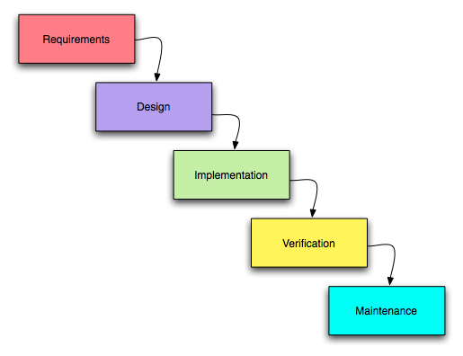
Waterfall Model
Notes:
12

Slide 13
Advantages of waterfall model
Each stage can be designated to a separate team allowing for greater control on the project.
The whole process can have deadlines set for each stage which should, in theory, make for the project being delivered on time.
Waterfall discourages revisiting and revising any prior phase once it's complete.
This model works well only for smaller projects where requirements are very well understood
Notes:
13

Slide 14
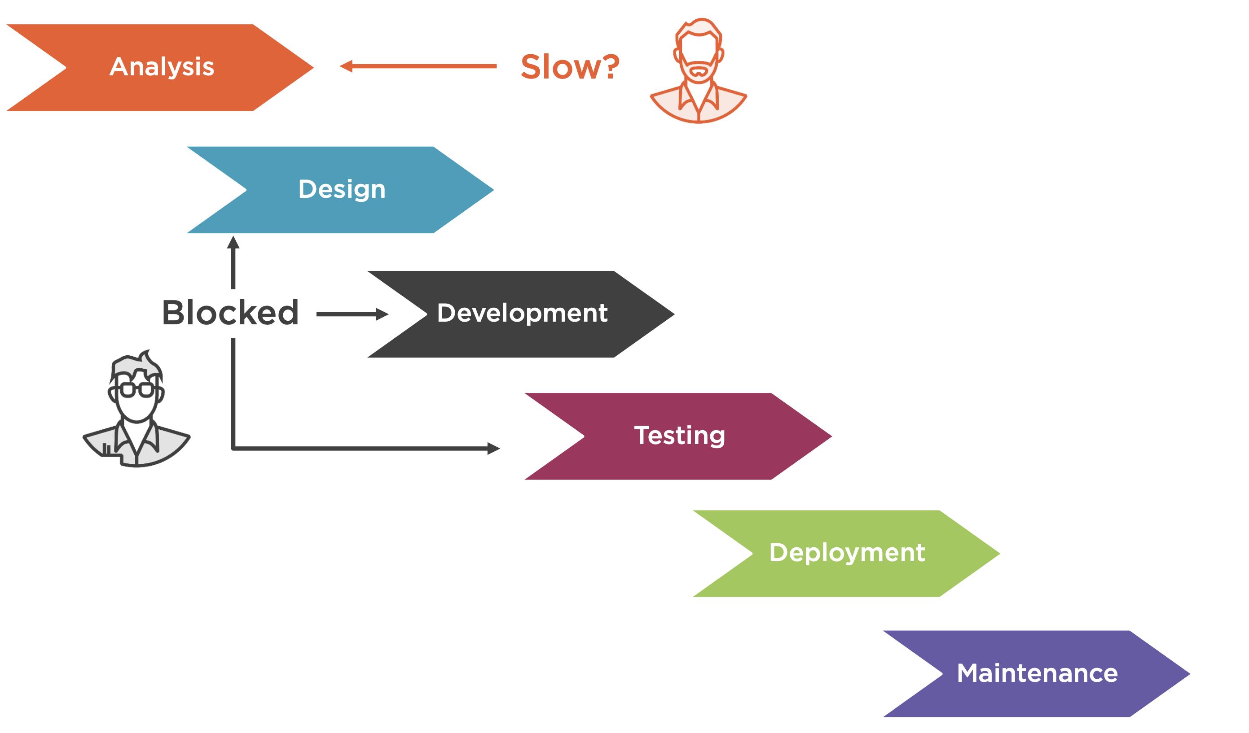

Slide 15
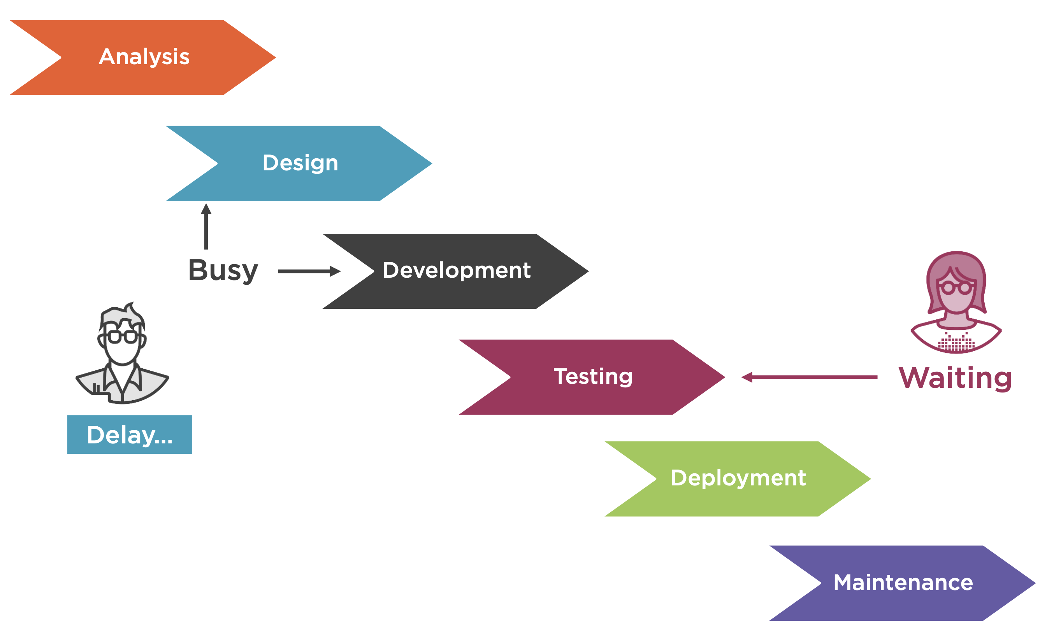

Slide 16
Disadvantages of waterfall model
Once an application is in the testing stage, it is very difficult to go back and change something that was not well-thought out in the concept stage
No working software is produced until late during the life cycle
High amounts of risk and uncertainty
Notes:
16

Slide 17
When to use the waterfall model
Requirements are very well known, clear and fixed
Technology is understood
Resources with required expertise are available
The project is small in scale
Notes:
17

Slide 18
V Model
‘V’ stands for the terms Verification and Validation.
This model developed as a result of the evolution of software testing.
Testing techniques and various kinds of testing got its due focus that led waterfall model to evolve into V-model.
Notes:
18

Slide 19
V Model
Testing of the product is planned in parallel with a corresponding phase of development
Each phase must be completed before the next phase begins.
Verification activities during requirements and design phase will produce deliverable like SRS and design documents.
Notes:
19

Slide 20
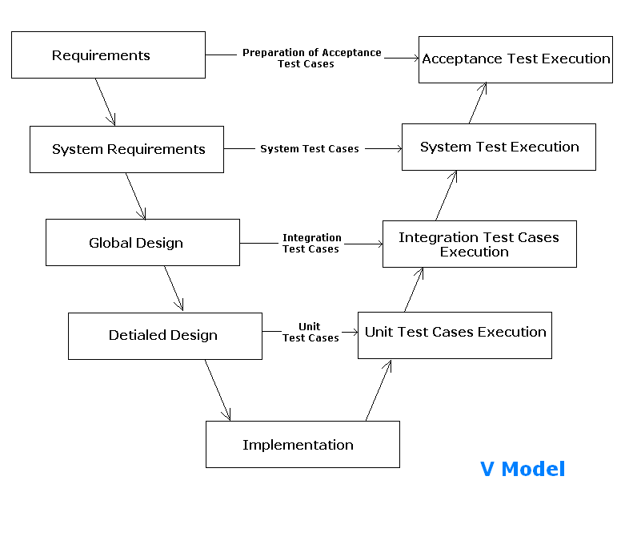
V Model
Notes:
20

Slide 21
V Model
Validation activities for each of the different type of test execution requires corresponding test cases to be prepared.
These test cases are prepared by taking help of corresponding requirements and design documents produced during verification activities.
This is what is represented in the 'V-Model' diagram as a input link between the descending form of verification activities and ascending form of corresponding validation activities.
Notes:
21

Slide 22
Advantages of V-model
Testing activities like planning, test designing happens well before coding. Hence higher chance of success over the waterfall model
Proactive defect tracking – that is defects are found at early stage.
Avoids the downward flow of the defects.
Works well for small projects where requirements are easily understood.
Notes:
22

Slide 23
Disadvantages of V-model
Software is developed during the implementation phase, so no early prototypes of the software are produced.
If any changes happen in midway, then the test documents along with requirement documents has to be updated.
Notes:
23

Slide 24
When to use the V-model
For small to medium sized projects where requirements are clearly defined and fixed.
Since, no prototypes are produced, there is a very high risk involved in meeting customer expectations.
Notes:
24

Slide 25
Agile Model
It is based on iterative and incremental development
Requirements and solutions evolve through collaboration between self-organizing, cross-functional teams
Agile methods work in cycles, typically of a week or a month, and at the end of each cycle, the priorities of the project are re-evaluated.
Notes:
25

Slide 26
Some of the well-known agile software development
methods include:
Scrum
Extreme Programming (XP)
Agile Unified Process (AUP)
Feature Driven Development (FDD)
Kanban
Notes:
26

Slide 27
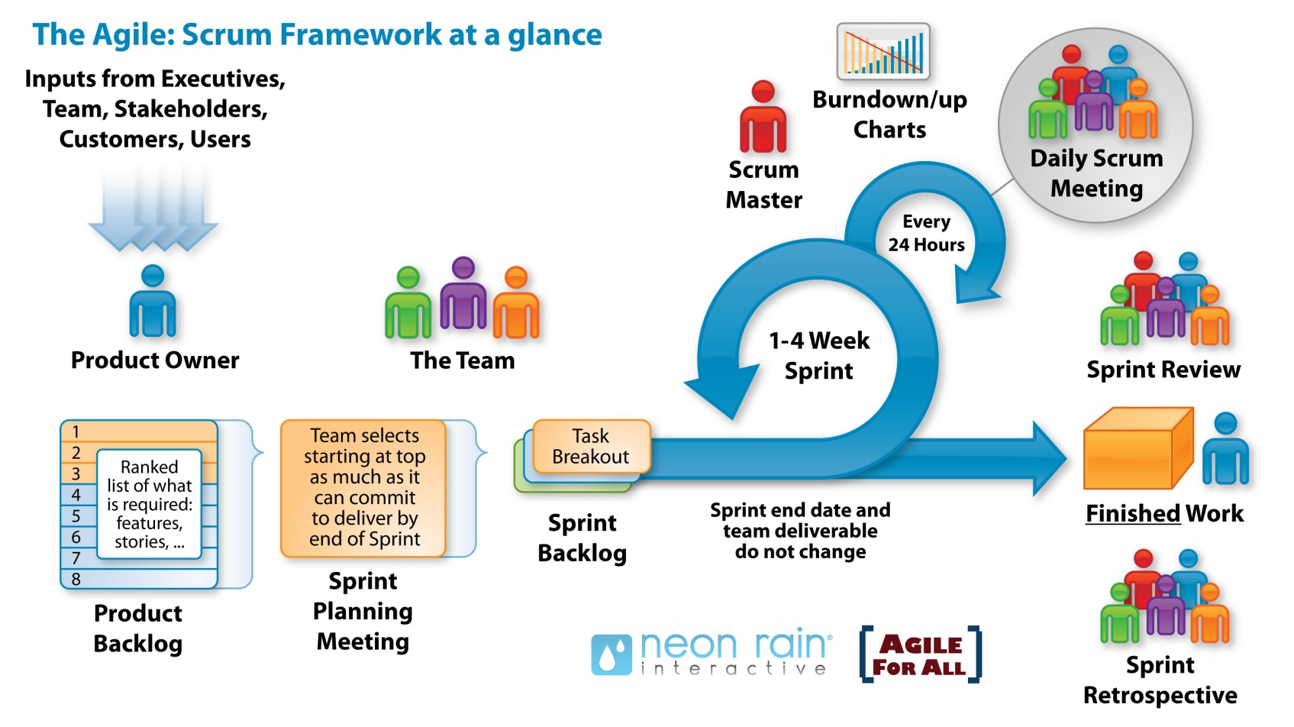
Notes:
27

Slide 28
Agile Model - Scrum
The four main principles of the Agile methods are:
1. Individuals and interactions over processes and tools 2. Working software over comprehensive documentation 3. Customer collaboration over contract negotiation 4. Responding to change over following a plan
Notes:
28

Slide 29
Scrum roles
Major roles in Scrum development process are:
Product Owner
Team
Scrum Master
Stakeholders
(Customers, end-users, vendors)
Notes:
29

Slide 30
Product Owner
Represents the stakeholders and is the voice of the customer.
He or she is accountable for ensuring that the team delivers value to the business.
This role should not be combined with that of the Scrum Master
Ranks and prioritizes deliverable items
Notes:
30

Slide 31
Team
Responsible for delivering potentially shippable product increments at the end of each Sprint.
Individuals with cross-functional skills who do the actual work; viz; analyze, design, develop, test, technical communication, document, etc.
Is self-organizing
Size is of 7 to 10 members
Notes:
31

Slide 32
Scrum Master
Accountable for removing impediments to the ability of the team to deliver the sprint goal or deliverable
He or she is not the team leader
Enforces compliance of rules of Scrum, often chairs key meetings, and challenges the team to improve
Notes:
32

Slide 33
Stakeholders
They are the people who enable the project and for whom the project produces the agreed-upon benefits
They may be involved in the Scrum process during the Sprint Review
Notes:
33

Slide 34
Sprint
A "time-boxed" effort, i.e. it is restricted to a specific duration
Each sprint is preceded by a Sprint planning meeting, where the tasks for the sprint are identified and an estimated commitment for the sprint goal is made
Sprint is followed by a review or retrospective meeting, where the progress is reviewed and lessons for the next sprint are identified
Notes:
34

Slide 35
Product Backlog
An ordered list of requirements that is maintained for a product
It consists of features, bug fixes, non-functional requirements, etc. - whatever needs to be done in order to successfully deliver a working software system
Product Owner is ultimately responsible for ordering the items
Notes:
35

Slide 36
Sprint Backlog
The list of work the development team must address during the next sprint
Tasks on the sprint backlog are never assigned; rather, tasks are signed up for by the team members as needed during the daily scrum according to the set priority and the Development Team member skills
This promotes self-organization of the Development Team and developer buy-in
Notes:
36

Slide 37
Agile Model - Scrum Process
The list of Sprint backlog is filled based on the team’s Capacity of how much they can complete in the next Sprint.
This promotes self-organization of the Development Team and developer buy-in
Once a Sprint's Product Backlog is committed, no additional functionality can be added to the Sprint except by the team
Notes:
37

Slide 38
Agile Model - Scrum Process
Once a Sprint has been delivered, the Product Backlog is analyzed and re-prioritized, if necessary, and the next set of functionality is selected for the next Sprint
Burn down chart
A chart showing remaining work in the sprint backlog is prepared and is publicly displayed
It is updated every day
Notes:
38

Slide 39
Advantages of Agile model
Customer satisfaction by rapid, continuous delivery of useful software
Working software is delivered frequently (in weeks rather than months)
Close co-operation between business and developers
Regular adaptation to changing circumstances
Notes:
39

Slide 40
Disadvantages of Agile model
For large projects, it is difficult to assess the effort required at the beginning of the software development life cycle
Lack of emphasis on necessary designing and documentation, may have adverse impact later
Without larger group of experienced resources in the team, it is difficult to take quick decisions as there is less time to do research
Notes:
40

Slide 41
When to use Agile model
Scenarios where end users needs are ever changing in a dynamic business and requires frequent customer feedback to develop solution
Notes:
41

Slide 42
SDLC and STLC

Slide 43
The Testing Process
Project Initiation
Test Strategy and Planning
Test Environment setup
Test Case Designing
Test Execution
Test Cycles
Defect Reporting and Tracking
Project closure

Slide 44
Discuss on Agile Process:: Grooming, Sprint Planning, Standup Call

Slide 45
Categories of Testing

Slide 46
Broad Categories of Testing
Software Testing
Static Testing
Dynamic Testing
Black Box Testing
White box Testing
Notes:
Testing the software by performing a manual inspection, review or
walkthrough is termed as Static Testing
Inspection: It is a technique in which the work product is examined for its
compliance to specific standards and also checked against a history of
common errors.
Review: It is a technique in which the work product is discussed upon by a
group of two or more persons and reexamined or revaluated for possible
corrections.
Walkthrough: It is a technique mostly done on the code developed, where
the code is traced manually to monitor the state of the program variables
as a way of analyzing the logic.
Testing the software by Dynamically executing the application is termed as Dynamic Testing.
Functional Testing : Functional Testing checks whether all the business functionalities are working fine as per the requirement from the customer.
Non-Functional Test: Testing that concentrates on the performance of the system like the
response time, speed of execution, usability, availability etc.

Slide 47
Dynamic Testing Techniques
White Box Testing
Tests at micro level of the programs that test each and every
implemented functional task, ensuring that all code options are
exercised. Requires knowledge of the internal code.
Black Box Testing
Testing that focuses solely on the outputs generated in response to
selected inputs and execution conditions. Requirements are the only
test basis and knowledge of the internal code is not required.

Slide 48
Dynamic Testing
(Validation)
Dynamic Testing Techniques
White Box
Black Box
Statement
Coverage
Equivalence
Partitioning
Branch or Decision
Coverage
Boundary Value
Analysis
Multiple Condition
Coverage
Decision Table
Loop Coverage
Cause Effect
Graph
Call Coverage
State Transition
Path Coverage
Notes:
The most commonly used techniques like Equivalence partitioning and Boundary value analysis and the White box Testing techniques are explained in detail in the next slides.

Slide 49
Black Box Technique : Equivalence Partitioning
Partitioning the input domain of a program into a finite number of classes
set to identify a minimal set of well selected test cases to represent these
classes.
There are two types of input equivalence classes, valid and invalid.
Equivalence class testing can significantly reduce the number of test cases
that must be created and executed
Notes:
Guidelines for equivalence classes
If an input condition specifies range, one valid and two invalid equivalence classes are needed
If a condition requires a specific value, then one valid and two invalid equivalence classes are needed
If an input condition specifies a member of a set, one valid and one invalid equivalence class are needed
If an input condition is Boolean, one valid and one invalid class are needed

Slide 50
Illustration for EP
EP may be best explained with an example of a function which has the pass parameter "month” of a date. The valid range for the month is 1 to 12, standing for January to December. This valid range is called a partition. In this example there are two further partitions of invalid ranges.
The first invalid partition would be <= 0 and the second invalid partition would be >= 13.
.... -2 -1 0 1 ...................12 13 14 15 .....
--------------------|-------------------|---------------------
Invalid partition I Valid partition Invalid partition II

Slide 51
Black Box Technique : Boundary Value Analysis
A selection technique in which test data are chosen to lie along "boundaries“ of the input domain [or output range] classes, data structures, procedure parameters, etc.
Choices often include maximum, minimum, and trivial values
Focus on the boundaries of the input
If input condition specifies a range bounded by a certain values, say, a and b, then test cases should include
The values for a and b
The values just above and just below a and b
If an input condition specifies any number of values, test cases should be
the minimum and maximum numbers,
the values just above and just below the minimum and maximum values
Notes:
Boundary value analysis:
Behaviour at the edge of each equivalence partition is more likely to be incorrect, so boundaries are an area where testing is likely to yield defects. The maximum and minimum values of a partition are its boundary values. Tests can be designed to cover both valid and invalid boundary values. When designing test cases, a value on each boundary is chosen.
Boundary value analysis can be applied at all test levels. It is relatively easy to apply and its defect finding capability is high; detailed specifications are helpful. This technique is often considered an extension of equivalence partitioning and can be used on input by humans as well as, for example, on timing or table boundaries. Boundary values may also be used for test data selection.

Slide 52
Illustration for BVA
If the same example of a function which has the pass parameter "month" of a date
Valid Class is 1<= month <=12
Invalid Class 1 is month <1
Invalid Class 2 is month >12
When compared to EP, which says select any test case within a range and any on either side of it , in BVA the emphasis is on the ‘edges’
1 and 12 for the ‘edges’ of the Valid class
7( a middle value ) for the Valid Class
0 and 13 for the Invalid class

Slide 53
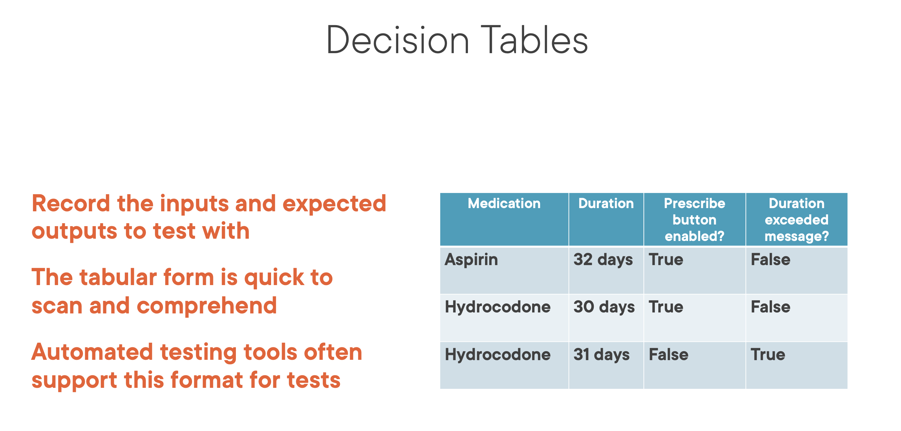

Slide 54
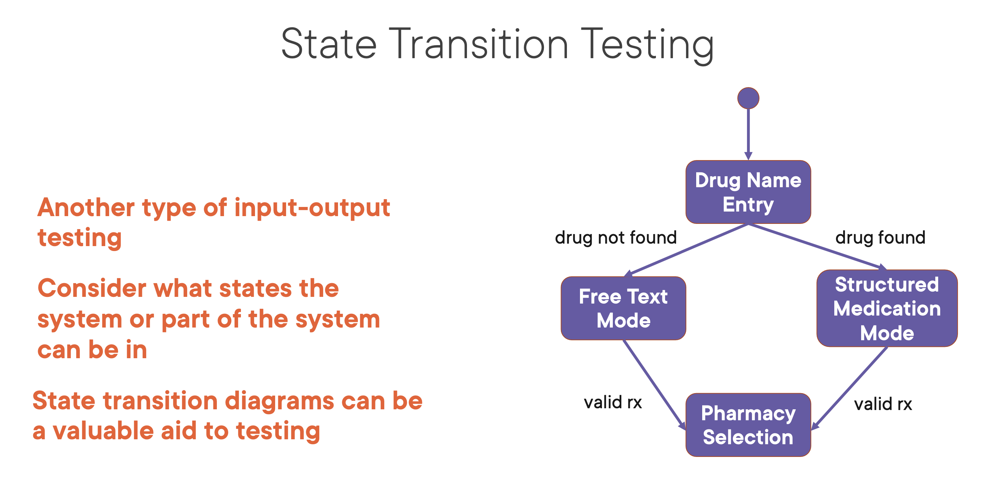

Slide 55
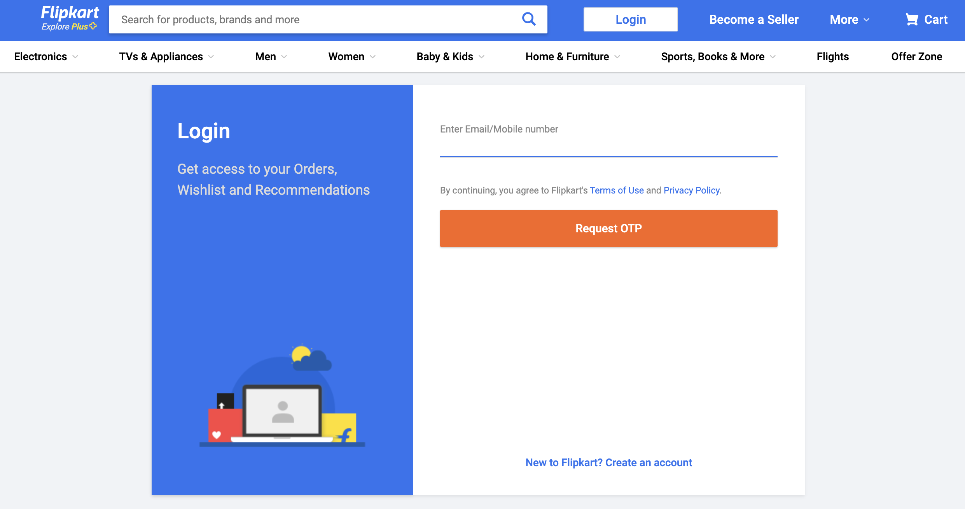
Equivalence Partition Test ?
BVA ?

Slide 56
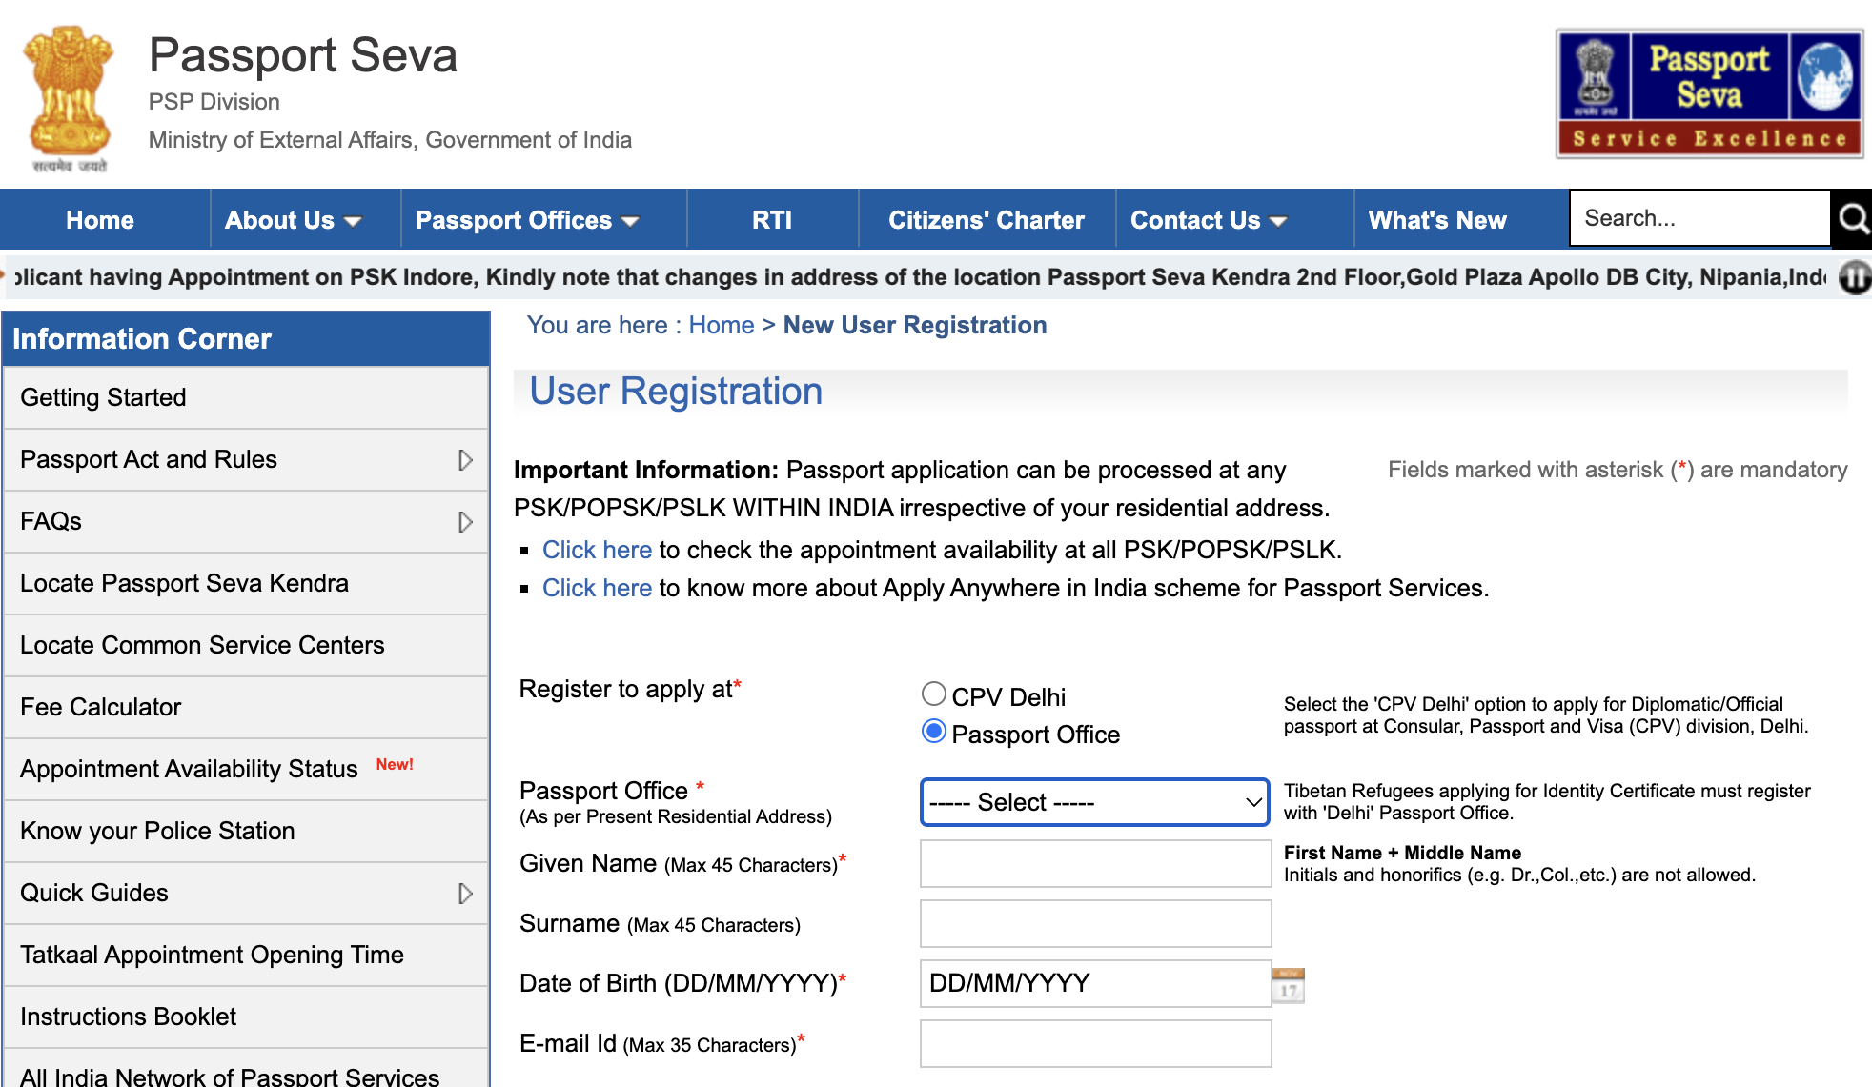
Equivalence Partition Test ?
BVA ?

Slide 57
White Box Technique: Statement Coverage
Testing to satisfy the criterion that each statement in a program to be executed at least once during program testing. Coverage is 100 percentage when a set of test cases causes every program statement to be executed at least once.
The chief disadvantage of statement coverage is that it is insensitive to
some control structures.
Example
1 int select ( int a[], int n, int x)
2 {
3 int i = 0;
4 while ( i < n && a[i] < x )
5 {
6 if (a[i] < 0)
7 a[i] = - a[i];
8 i++;
9 }
10 return 1;
11 }
One test case n=1, a[0]=-7, x=9 covers everything ,
Flow 1 - > 2 - > 3 - > 4 - > 5 - > 6 - > 7 - > 8 - > 9 - > 10 - > 11

Slide 58
White Box Technique: Branch or Decision Coverage
A test coverage criteria which requires that for each decision point or each
possible branch be executed at least once
Example
1 int select ( int a[], int n, int x)
2 {
3 int i = 0;
4 while ( i < n && a[i] < x )
5 {
6 if (a[i] < 0)
7 a[i] = - a[i];
8 i++;
9 }
10 return 1;
11 }
Test Data
Branch coverage | i | n | x | a[i] | Branch Outcome
while ( i < n && a[i] < x ) | 0 | 1 | 9 | -7 | True
 | 0 | 1 | 7 | 9 | False
Flow A : 1 - > 2 - > 3 - > 4 - > 5 - > 6 - > 7 - > 8 - > 9 - > 10 - > 11
Flow B : 1 - > 2 - > 3 - > 4 - > 10 - > 11

Slide 59
White Box Technique: Multiple Condition Coverage
A test coverage criteria which requires enough test cases such that all possible combinations of condition outcomes in each decision, and all points of entry, are invoked at least once.
A large number of test cases may be required for full multiple condition coverage
Example
Test Data
1 int select ( int a[], int n, int x)
2 {
3 int i = 0;
4 while ( i < n && a[i] < x )
5 {
6 if (a[i] < 0)
7 a[i] = - a[i];
8 i++;
9 }
10 return 1;
11 }
Multiple Condition Coverage | i | n | a[i] | x | Outcome
while ( i < n && a[i] < x ) | 0 | 4 | -10 | 10 | True
 | 0 | 4 | 10 | 10 | False
 | 0 | -4 | -10 | 10 | False
 | 0 | -4 | 10 | 10 | False
if ( a[i] < 0 ) | - | - | -10 | - | True
 | - | - | 10 | - | False
Notes:
Flow A : 1 - > 2 - > 3 - > 4 - > 5 - > 6 - > 7 - > 8 - > 9 - > 10 - > 11
Flow B : 1 - > 2 - > 3 - > 4 - > 10 - > 11
Flow C : 1 - > 2 - > 3 - > 4 - > 5 - > 6 - > 9 - > 10 - > 11

Slide 60
White Box Technique: Loop Coverage
A test coverage criteria which checks whether loop body executed zero times, exactly once or more than once
Example
Test Data
main ( )
{
int i, n, a[10],x;
printf (“Enter the values”);
scanf (“%d %d %d %d”, &i, &n, &a[i], &x);
while ( i < n && a[i] < x )
{
if (a[i] < 0)
a[i] = - a[i];
i++;
}
printf (“%d” , a[i] );
}
Loop Coverage | i | n | x | a[i] | loop called
while ( i < n && a[i] < x ) | 0 | 4 | 5 | 10 | 0 times
 | 3 | 4 | 5 | -10 | 1 time
 | 1 | 4 | 5 | -10 | 3 times

Slide 61
White Box Technique: Call Coverage
A test coverage criteria which checks whether function called zero times, exactly once or more than once
Example
Test Data
main ( )
{
int a, b, i ;
printf (“Enter the value of a, b, i”);
scanf (“ %d %d %d “, &a ,&b, &i);
if ( i < 10 )
{
sample ( a, b);
i = i + 1;
}
}
sample ( int x , int y )
{
If ( x > 10 )
x = x + y ; break ;
if ( y > 10 )
y = y + x ; break ;
}
Call Coverage | a | b | i | function called
sample ( int x, int y ) | 2 | 4 | 10 | 0 times
 | 2 | 4 | 9 | 1 time
 | 2 | 4 | 7 | 3 times

Slide 62
White Box Technique: Path Coverage
Testing to satisfy coverage criteria that each logical path through the program be tested. Often paths through the program are grouped into a finite set of classes. One path from each class is then tested
General coverage requires executing all paths, number of paths may be infinite if there are loops

Slide 63
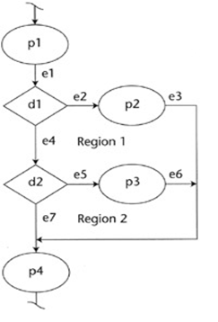
White Box Technique: Path Coverage continued…
Example
Linear Independent Paths
Path 1 -> p1 – d1 – d2 – p4
Path 2 -> p1 – d1 – p2 – p4
Path 3 -> p1 – d1 – d2 – p3 – p4
Sample Program
1 sample ( int x , int y )
{
2 If ( x > 10 )
3 x = x + y ; break ;
4 if ( y > 10 )
5 y = y + x ; break ;
}
6 printf (“%d %d”, x , y);
1
2
3
4
5
6

Slide 64
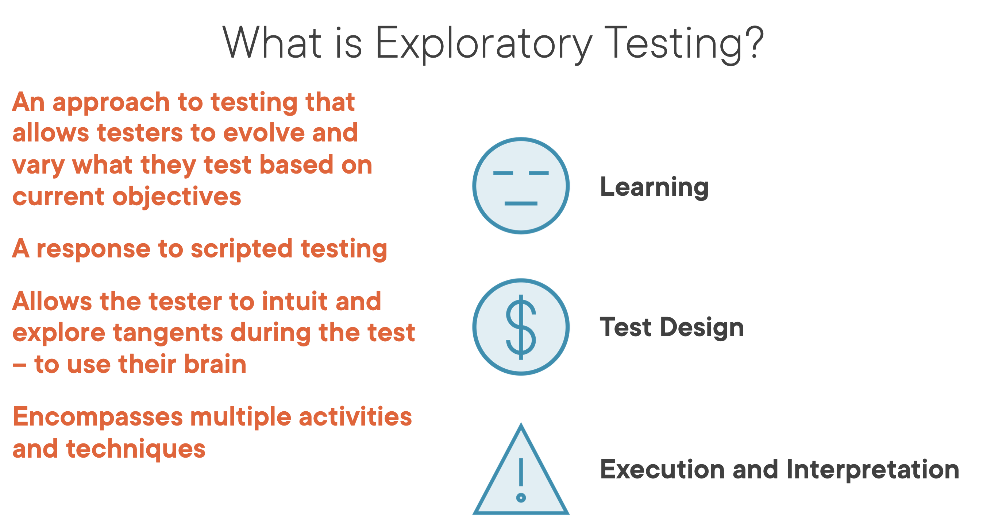

Slide 65
Levels of Testing
There are broadly four levels of Testing done in any Testing Project
Unit Testing
Integration Testing
System Testing
Acceptance Testing
The first 2 levels concentrate mainly on the “Functional aspects”.
During System Testing level, the functionality of the application is tested first, and then the
non-functional aspects mainly the “Performance” of the application can be tested.
Acceptance Testing is the last level of testing in the SDLC
Apart from the ‘Performance’ there are other non-functional aspects that can be tested in
the application as per the requirements

Slide 66
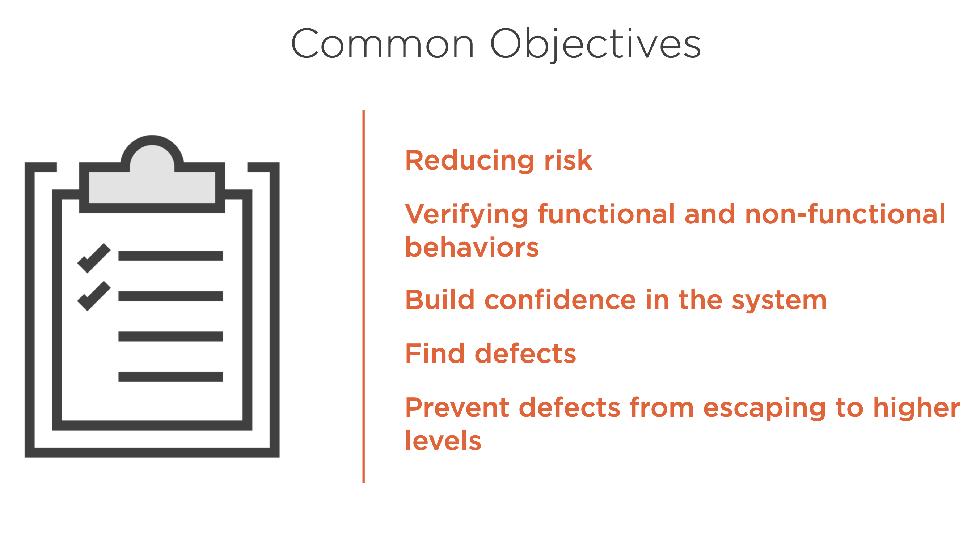

Slide 67
Unit Testing
To test a unit of code (program or set of programs) using Unit Test Specifications,
after coding is completed. Involves the basic testing of a piece of code, the size of
which is often undefined in practice, although it is usually a function or a subroutine
• Example
– Testing of a cobol program in the reservation system that calculates the price for the
ticket requested based on the inputs supplied to the program from the calling cobol
program.

Slide 68
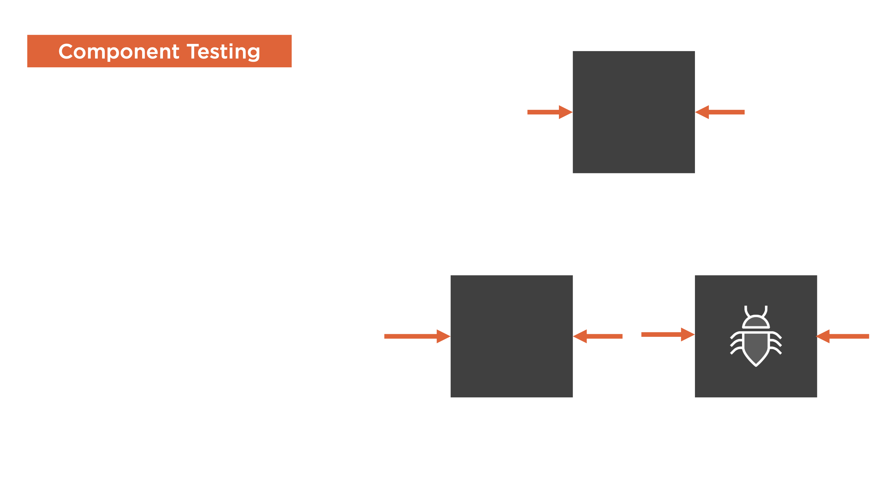

Slide 69
Integration Testing
The process of testing interfaces and data flows between the programs within a sub system,and between the sub-systems within a system.
Integration testing means that the tester must look for bugs in the relationship and the interfaces between pairs of components and groups of components under test.

Slide 70
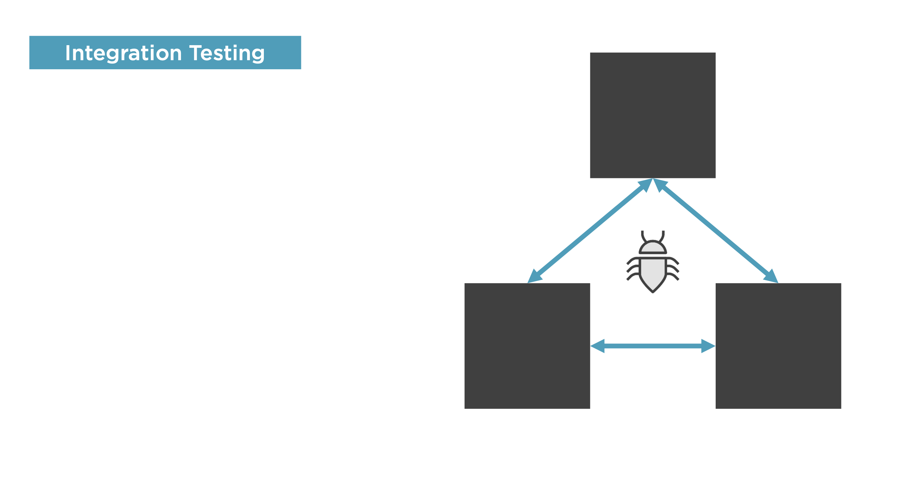

Slide 71
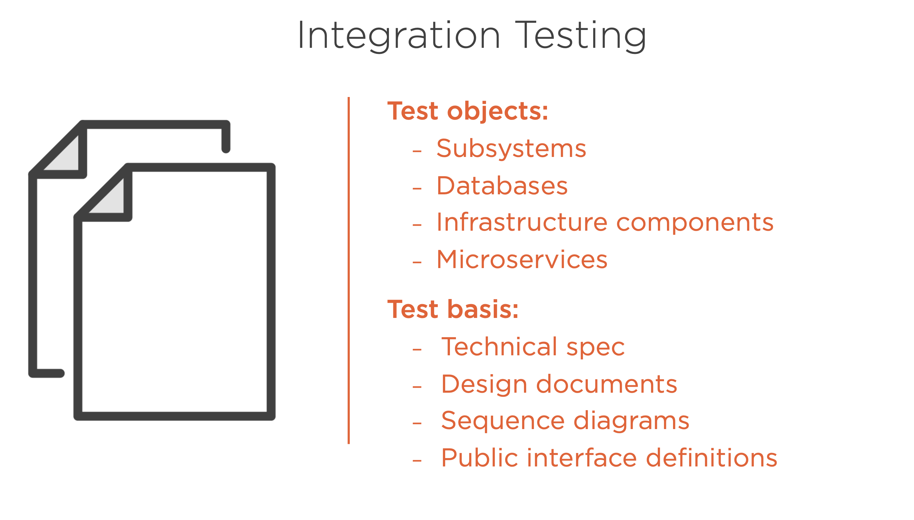

Slide 72
System Testing
It is a test, executed by the developer or independent test team in a laboratory
environment that should demonstrate that the developed system or subsystems meet
the requirements set in the functional and quality specifications.
The process of proving that the system meets its stated design specifications (design
documents) w.r.t criteria such as recoverability, maintainability and security.
• Example
– Comprehensive black box testing of railway reservation system with transactions
initiated and validations performed on databases and reports generated after the
completion of the transactions.

Slide 73
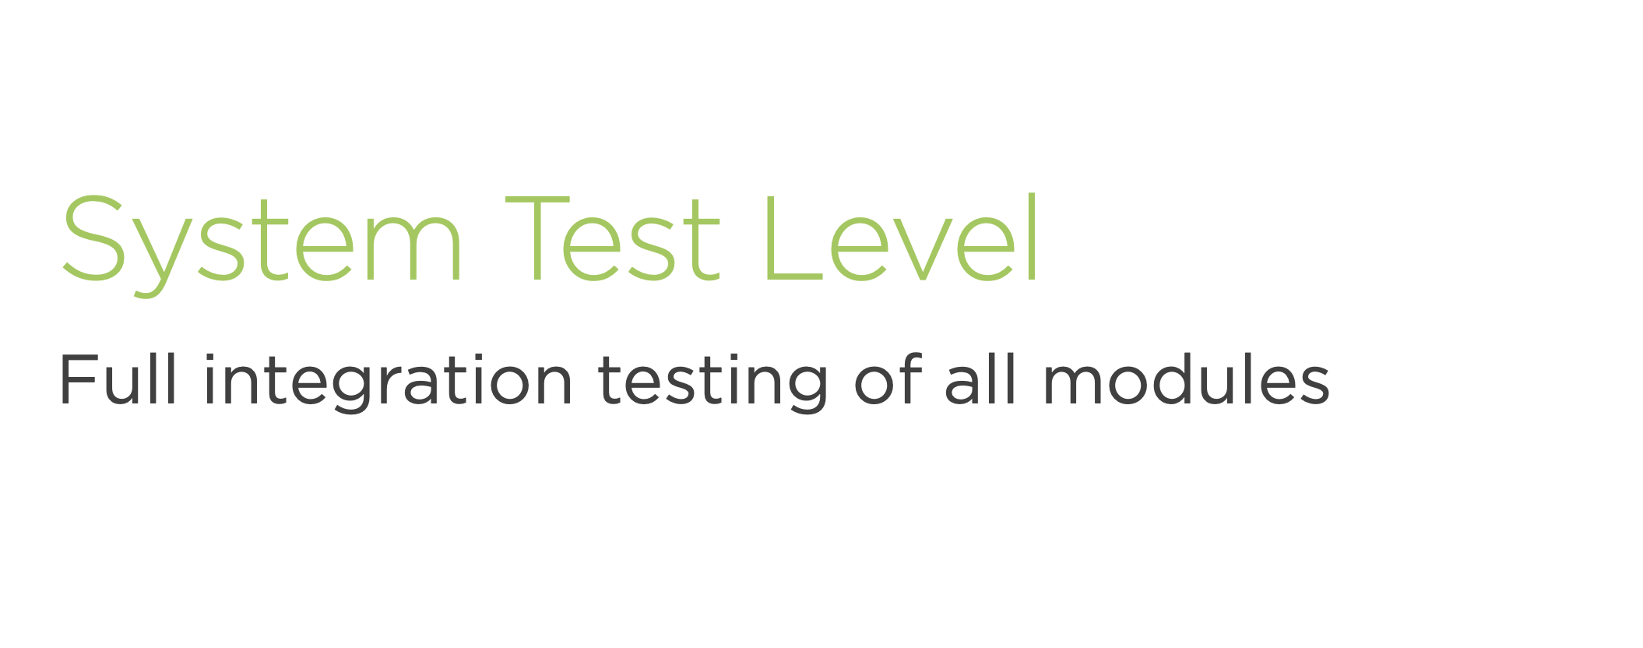

Slide 74
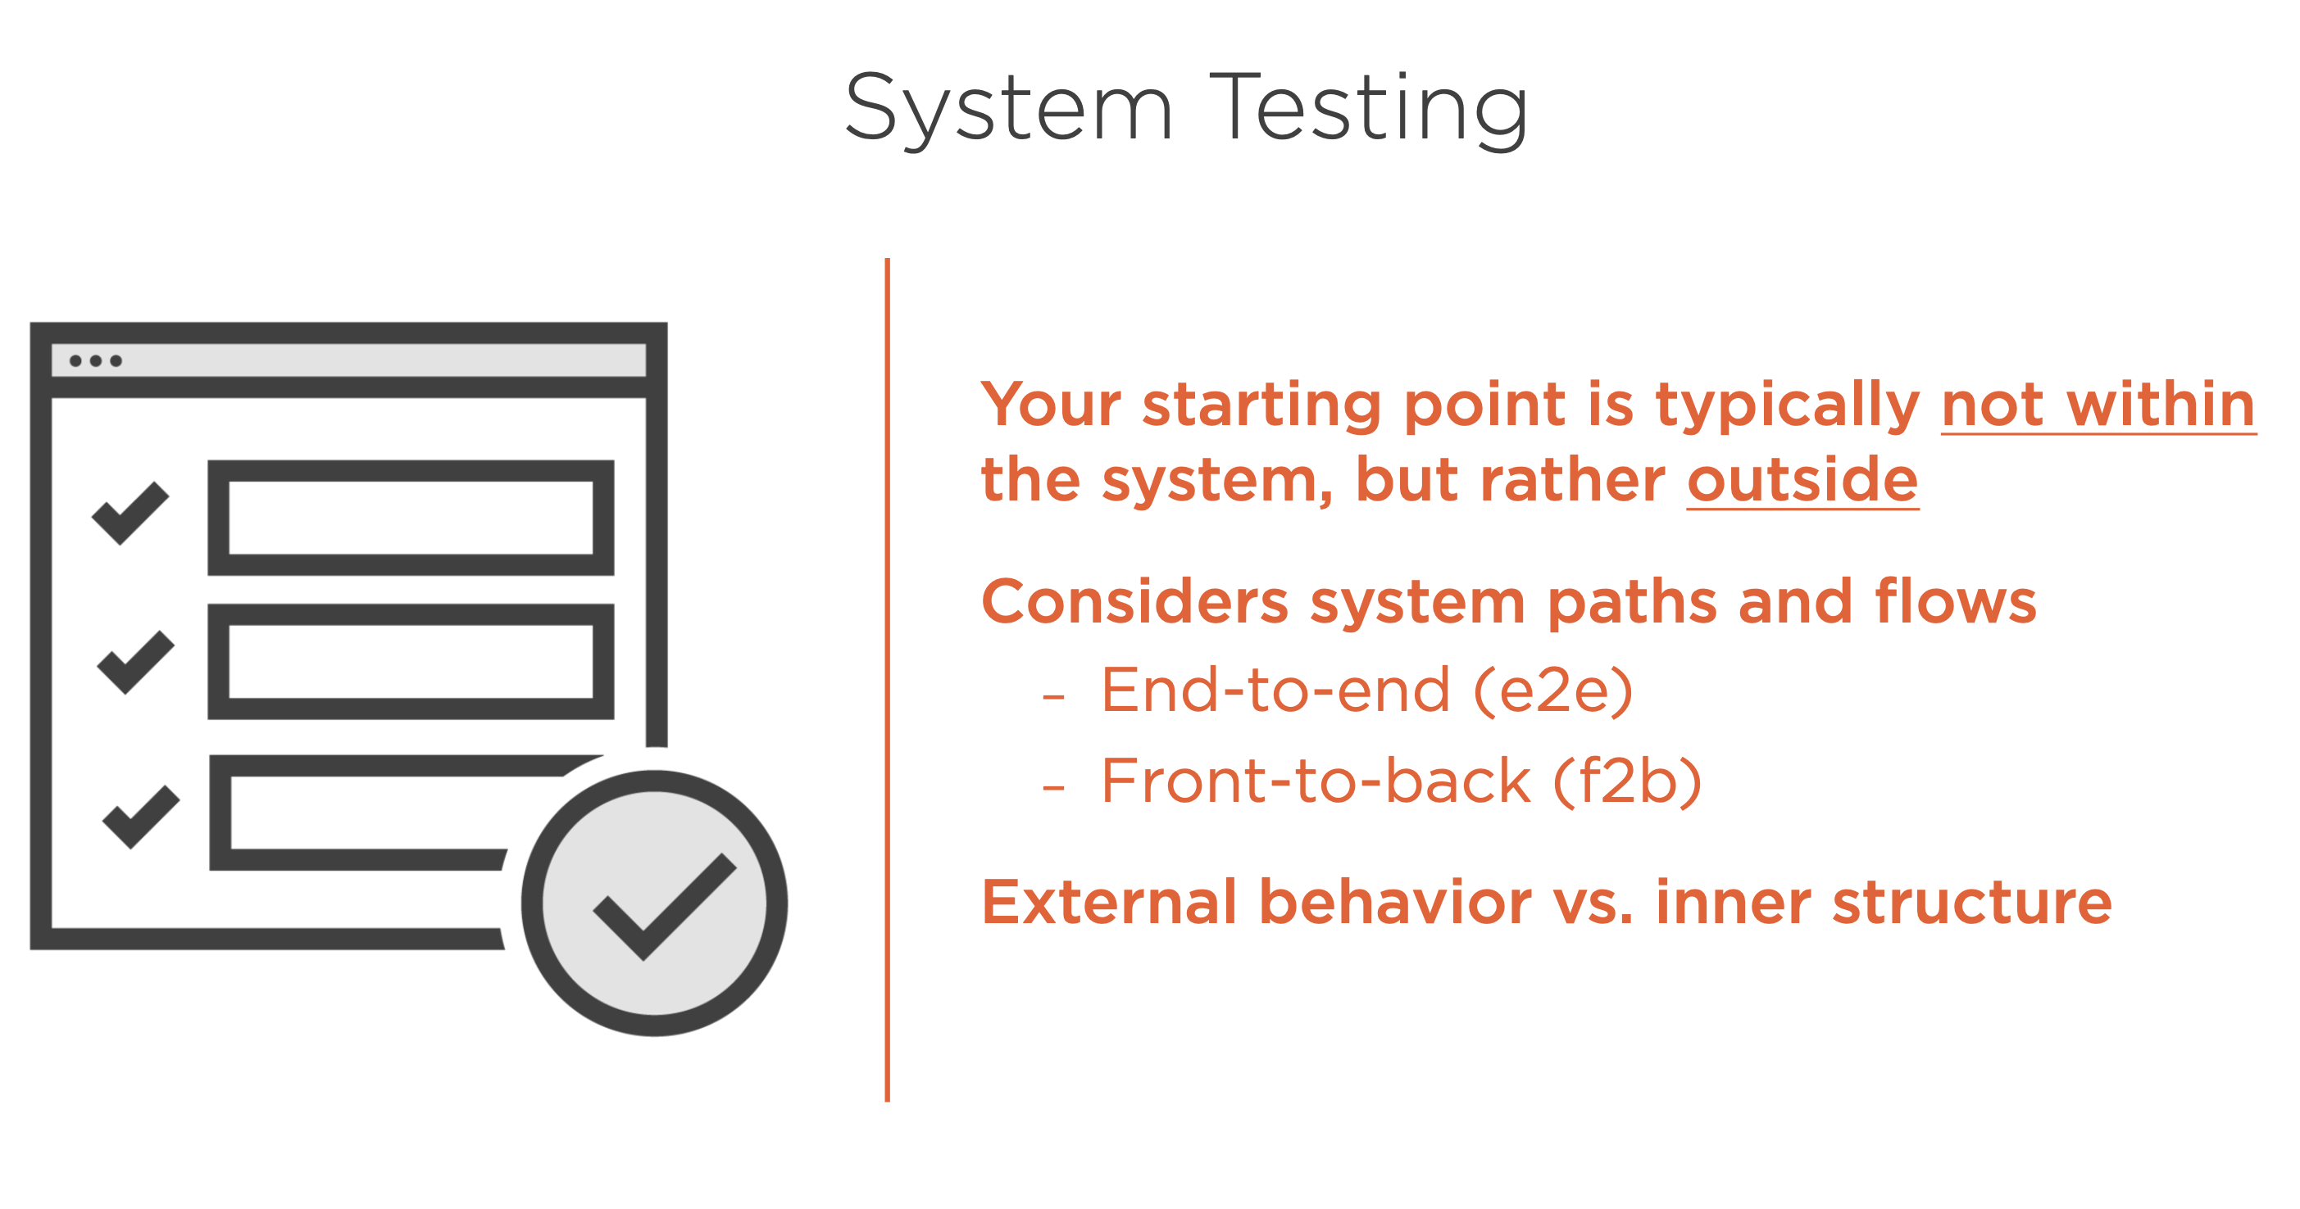

Slide 75
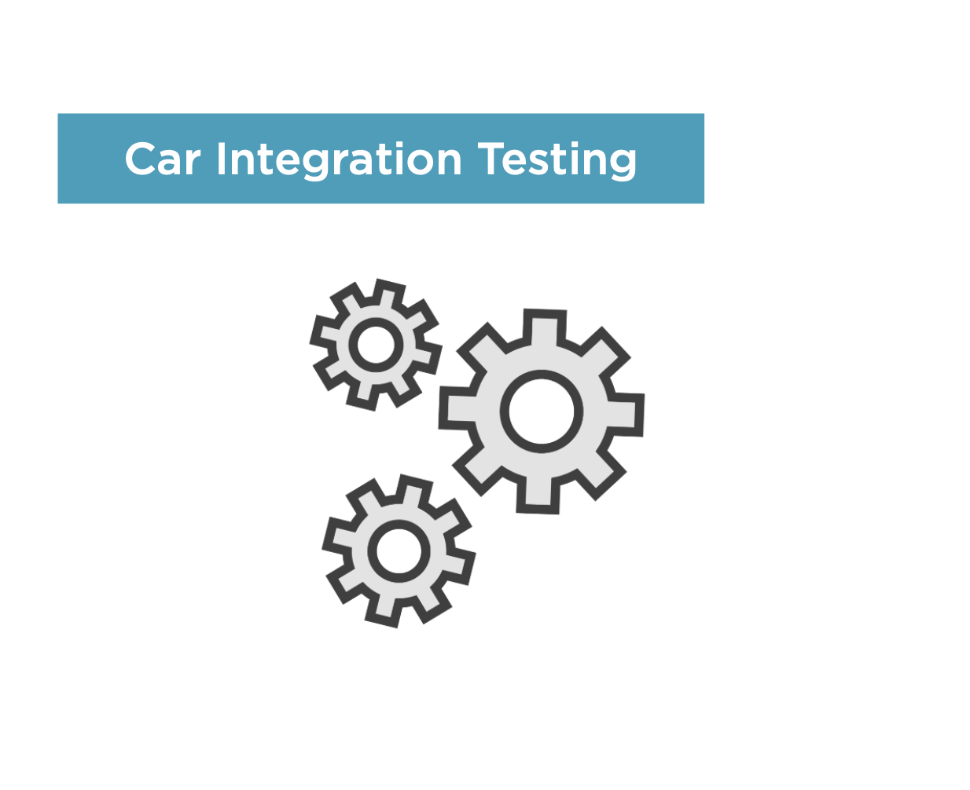

Slide 76
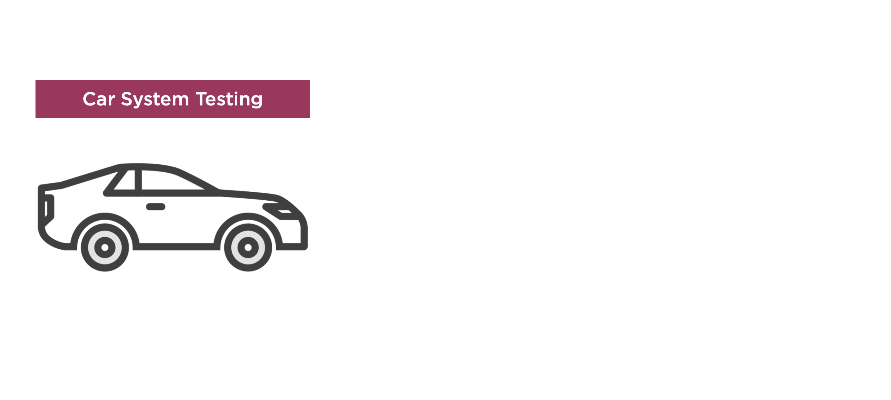

Slide 77
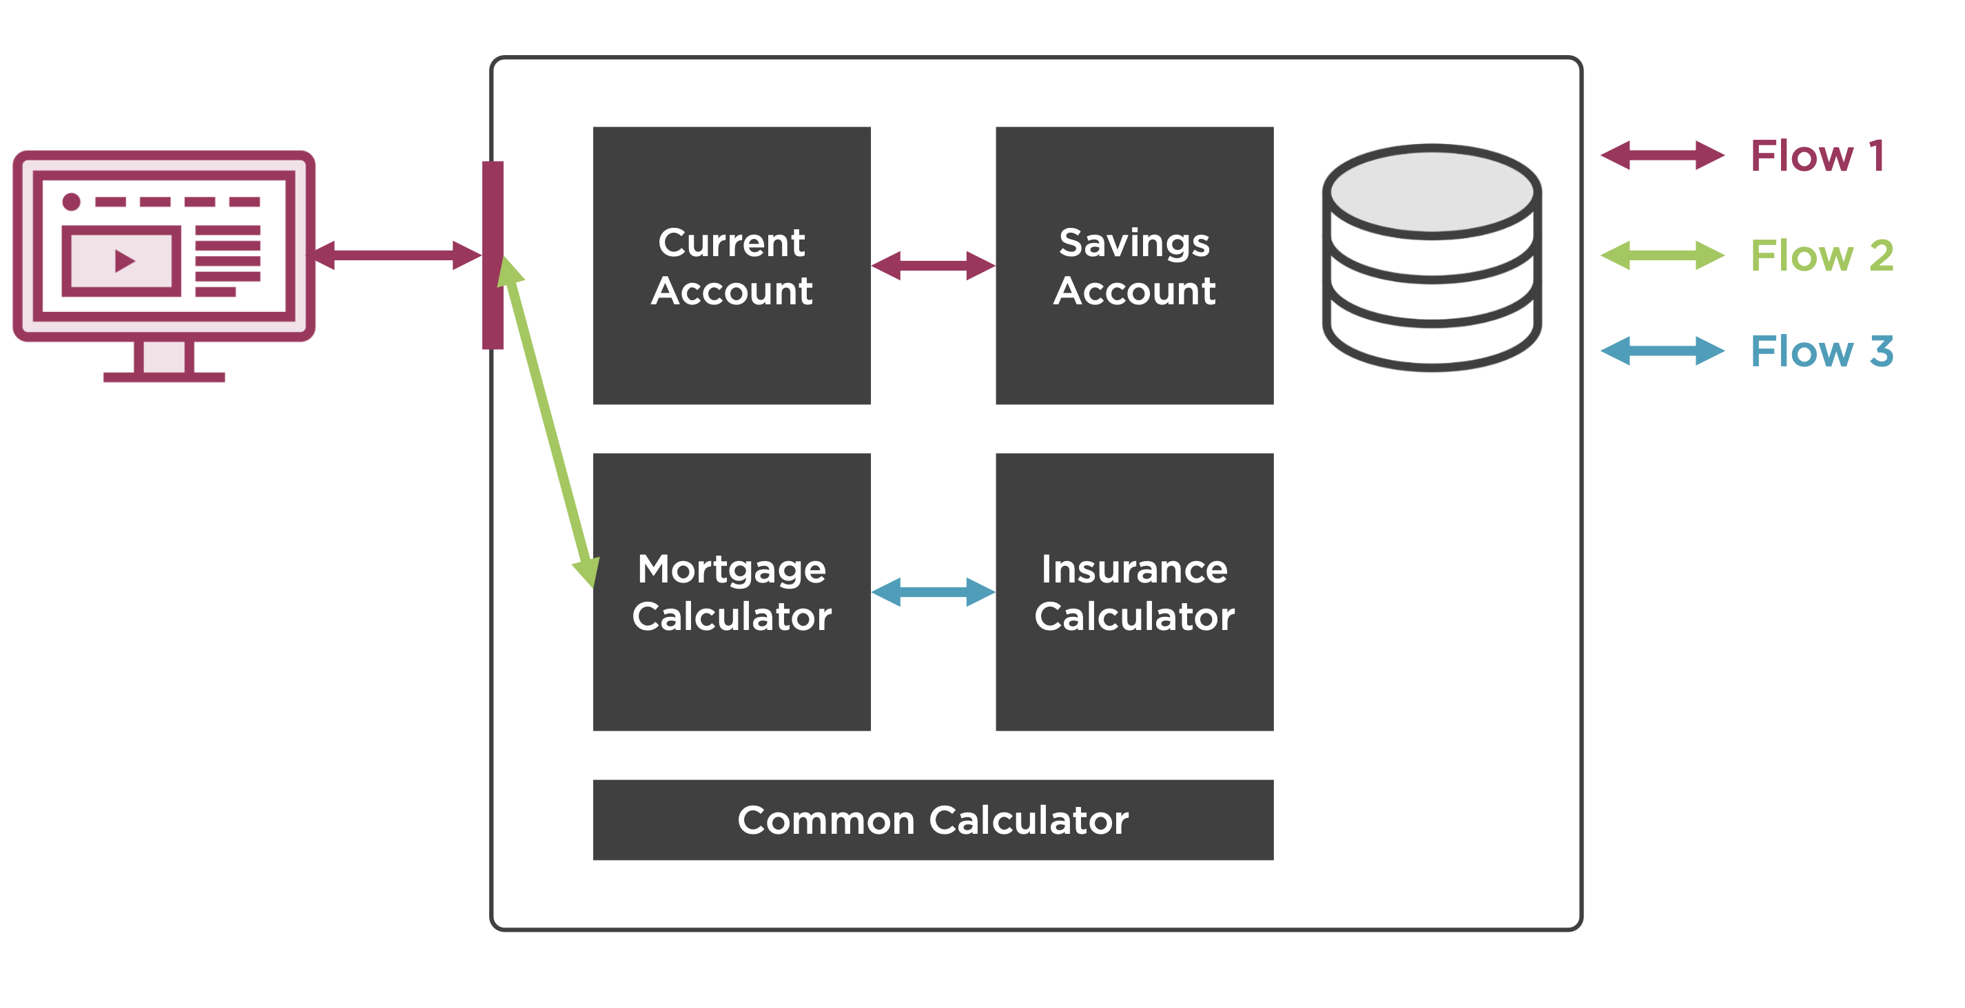

Slide 78
Acceptance Testing
It is a test, executed by the user(s) and system manager(s) in an environment simulating the operational environment to the greatest possible extent, that should demonstrate that the developed system meets the functional and quality requirements.

Slide 79
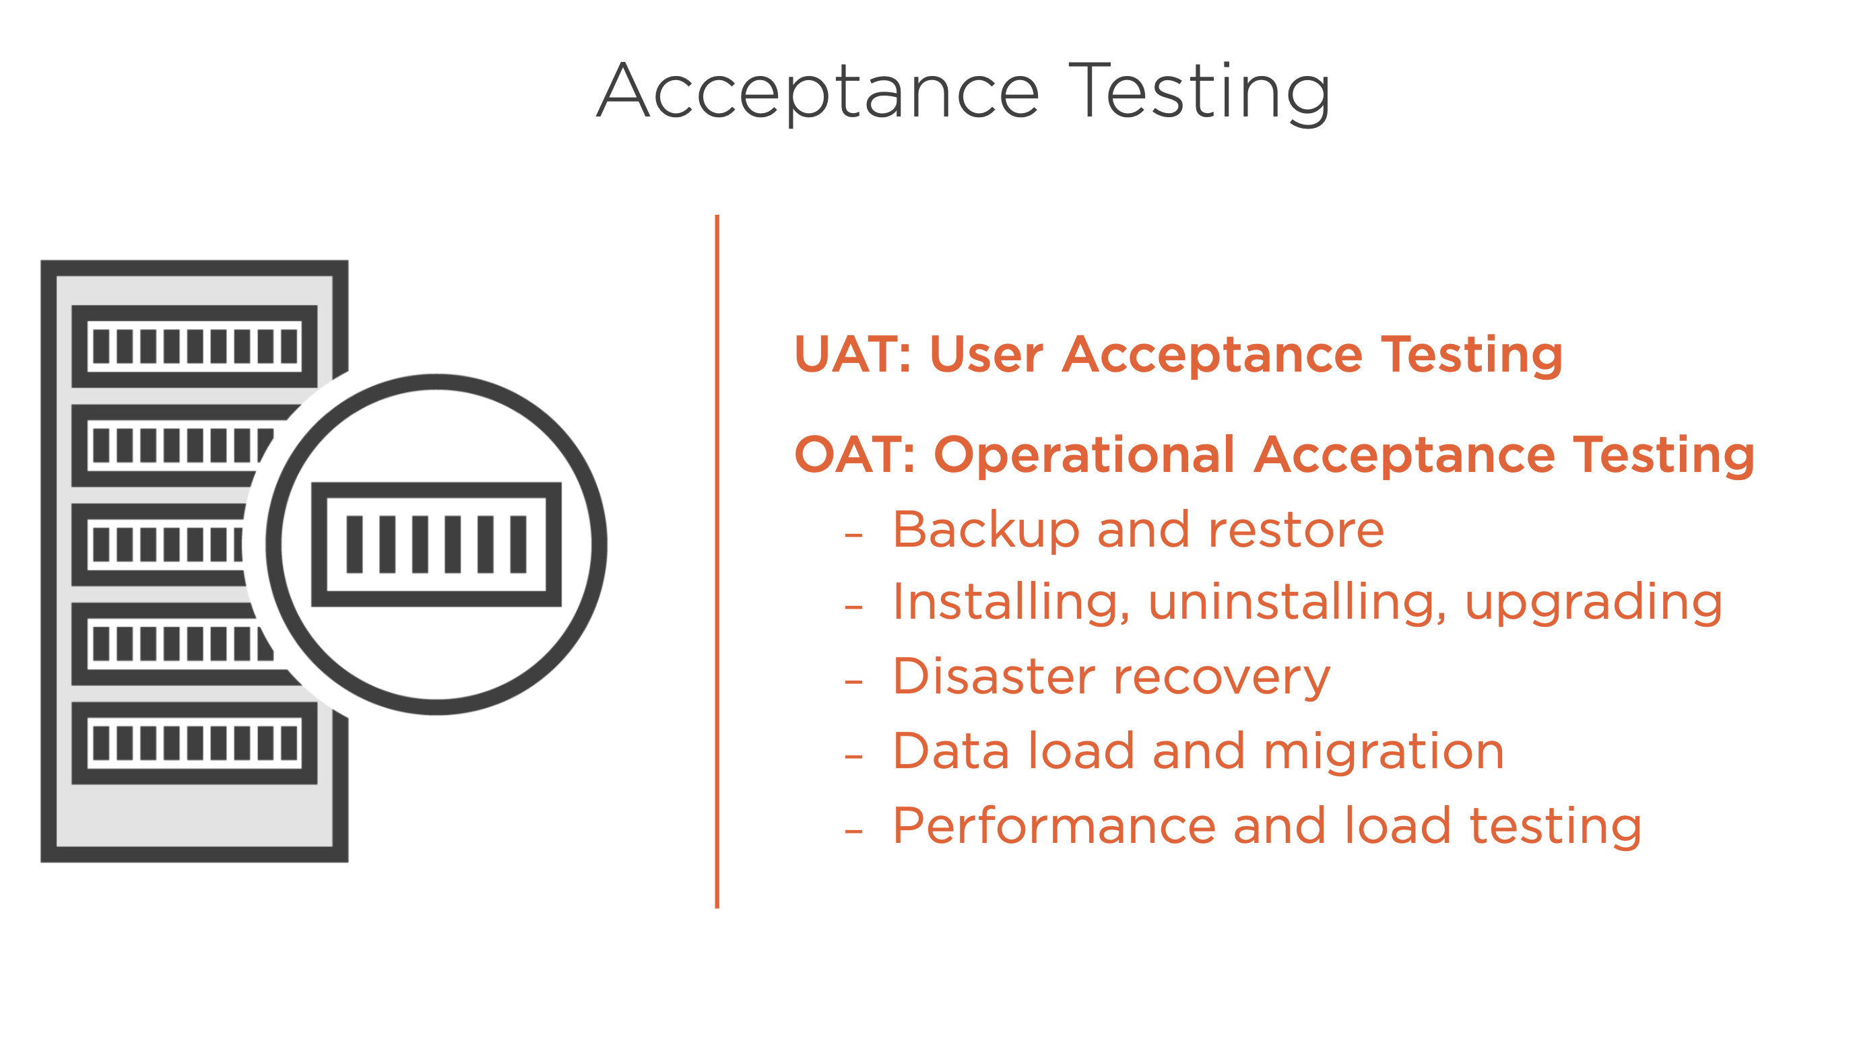

Slide 80
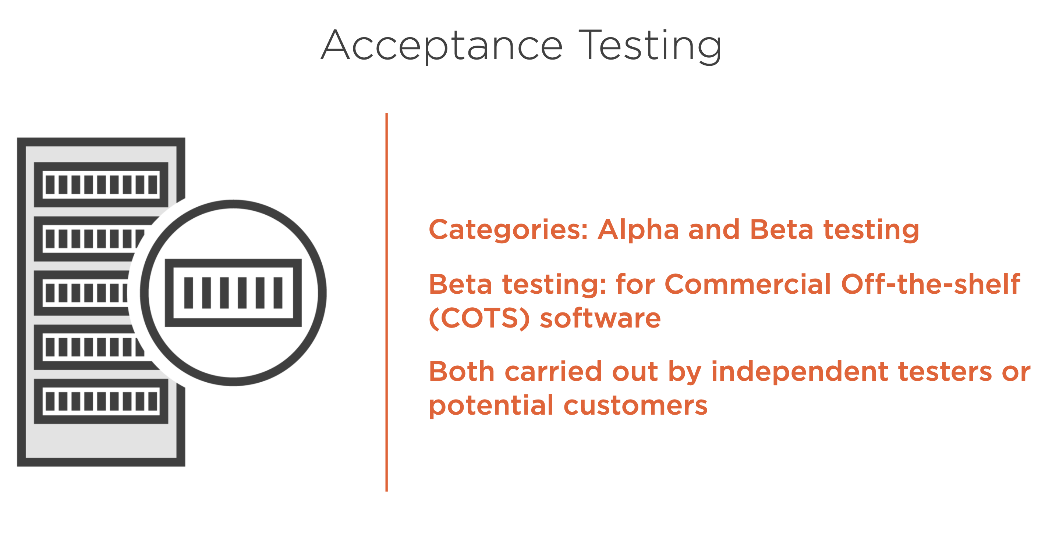

Slide 81
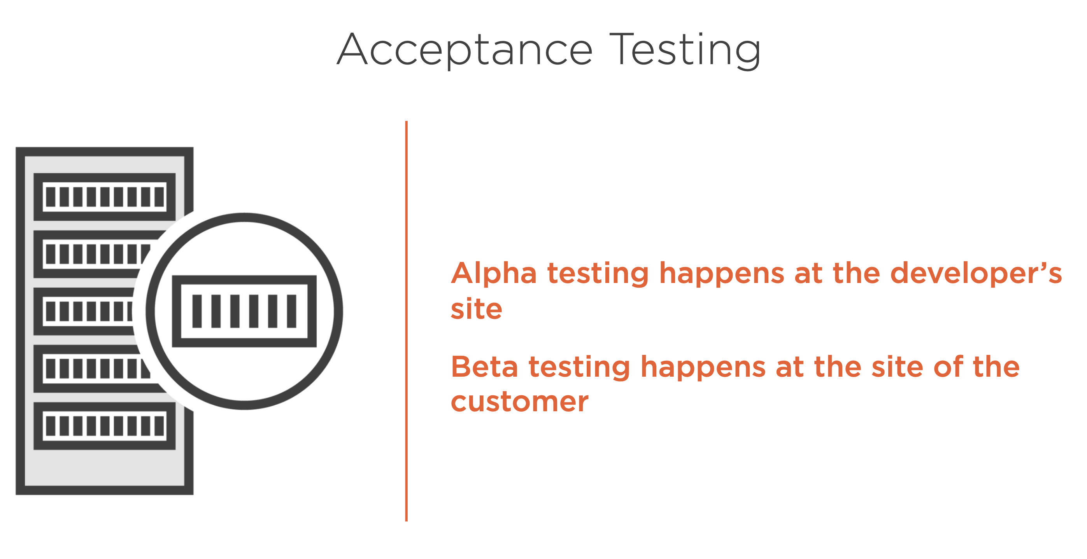

Slide 82
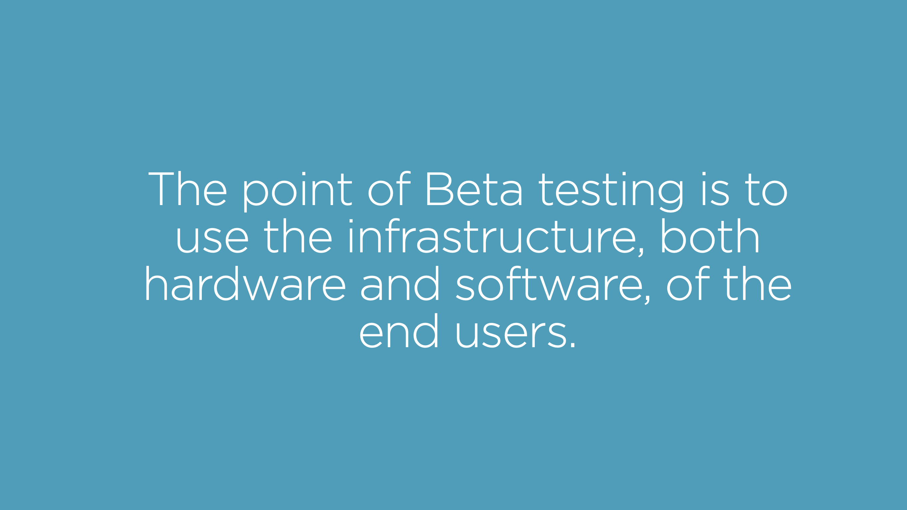

Slide 83
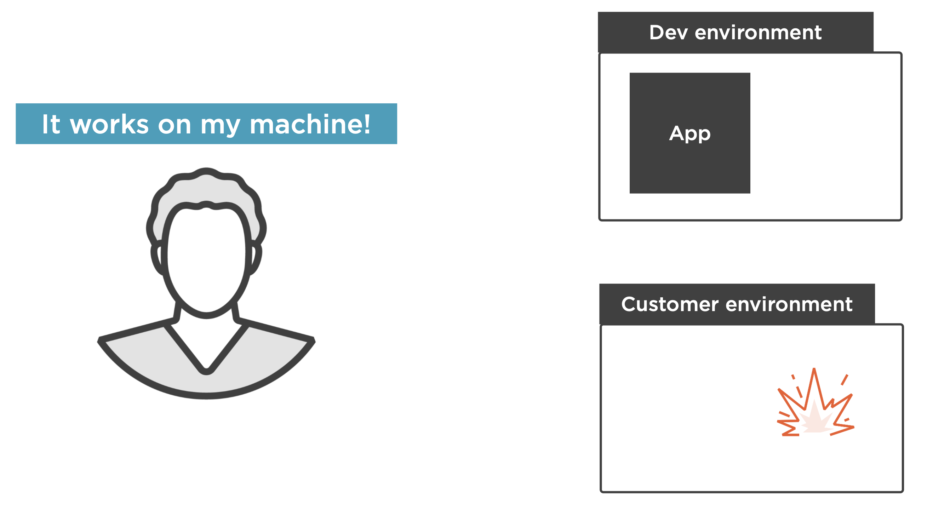

Slide 84
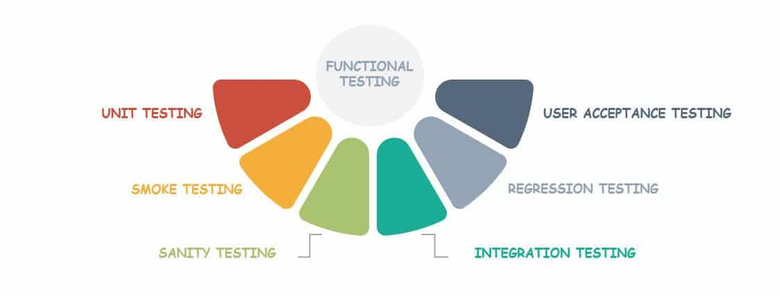
Functional Testing

Slide 85
Non-Functional & Other types of Testing
Performance testing
Volume testing
Load testing
Limit testing
Stress testing
Disaster Testing
Recovery testing
Security testing
Reliability testing
Installation Testing
Usability Testing
Accessibility Testing
Regression testing

Slide 86
Testing Artifacts and Test Design

Slide 87
Objectives
Importance of Documentation
Testing Artifacts
Introduction to Test Design
Test Environment and Test Data

Slide 88
Testing Documentation
Integral part of testing
Important for conducting the test and reuse of the test program during maintenance
Test documentation should start in the requirements phase and continue throughout the life cycle of the project
Structured documentation is easier to update and reuse
Good Documentation makes Testing “tester” independent
Every stage of Testing Lifecycle should be documented correctly.

Slide 89
Testing Artifacts
The important artifacts in Software Testing are:
Test Strategy
Test Plan
Test Design Specification
Test Case Specification
Test Execution Log
Test Defect Report
Test Summary Report

Slide 90
Testing Artifacts Contd...
Activities carried out at the Test Strategy level are as given below.
Define test objectives, scope of testing, testing phases and activities
Define testing Approach, Identifying high risk items.
Test Environment and Test Data set up
Define test dependencies, Test assumptions, test completion and user acceptance criteria
Establish configuration standards and defect management
The schedule of the project will be documented in the test plan. The test strategy details with application specific data will also be present in Test plan.
Test Design specification gives a high level test conditions and Test Case specification details how the identified test conditions are tested.
Test Log and Test Defect Report are prepared during Test Execution Phase.
Test summary report contains summary of product tested ,summary of results, summary of activities ,Sign off documents etc.

Slide 91
Test Design
The test objectives established in the test plan should be decomposed into individual test cases. Begin the process with identifying high-level test conditions. These are decomposed into lower and lower objectives until functional and structural test objectives are defined individually.
The main steps involved in Test Design phase are listed below.
Identify test resources.
Identify conditions to be tested – Test Scenario preparation.
Prioritize the test conditions.
Determine the Expected Results for each scenario.
Create test cases for the approved test scenarios.
Notes:
Identified Test Scenarios (High level test conditions) with expected results need to be prioritized as per the business criticality and Usage in Production. The prioritization details are given in the next slide.
Test scenarios need to be reviewed and approved before starting Test Case preparation.
The test case should have Test Case ID, Test Case Description, Test Steps, Test Step description, Expected Results, Priority and Requirement ID. Pre-requisites and Test Data need to be updated whenever required.

Slide 92
Test Prioritization
High
Priority – 1
(P1)
Priority – 1
(P1)
Usage in Production
Priority – 3
(P3)
Priority – 2
(P2)
Low
Low
High
Business Criticality
Usage in Production
High | Functionality is used extensively in production
Medium | Functionality is used moderately in production
Low | Functionality is rarely used in production
Business Criticality Defined based on : Financial & Consumer Impact, Potential Regulatory impact,
High | If the vulnerability could affect critical business process
Medium | If the vulnerability could affect supporting activities of Business process
Low | If the vulnerability could affect individuals and activities that are not necessarily related to business
92
Notes:
92
Note: P1→ High
P2 → Medium
P3 → Low

Slide 93
What is a Test Case?
It is the smallest unit of Testing
A test case is a detailed procedure that fully tests a feature or an aspect of a feature. Whereas the test plan describes what to test, a test case describes how to perform a particular test.
A test case has components that describes an input, action or event and an expected response, to determine if a feature of an application is working correctly.
Test cases must be written by a team member who thoroughly understands the function being tested.

Slide 94
Language usage in Test Case writing
Use Simple and Easy-to-Understand language
Use Active voice while writing test cases For eg.
Click on OK button
Navigate to the account Summary page.
Use words like “Verify” for starting any sentence in Test Case description For eg.
Verify whether the account information gets displayed on clicking the “Account Summary” menu
Use words like “Must” and use Future Tense for Expected Results. For eg.
The application must display the account information screen
The test case should have Test Case ID, Test Case Description, Test Steps, Test Step description, Expected Results, Priority and Requirement ID. Pre-requisites and Test Data need to be updated whenever required.

Slide 95
Test Case Development:
Use cases and Requirements from Client
Understand the requirements
Define the approach and number of test cases
Develop detail test procedures for scenarios
Send Query log for clarifications
Identify high level scenarios
Perform review on the completed test cases
Send Estimates and plan for Testing
Send the scenarios for review
Update the review findings
Prepare Traceability matrix
Deliver to client for signoff

Slide 96
Test Environment and Test Data
Test Environment
A dedicated Test environment allows failures to be consistently and accurately
recreated and ensures that the software under test will behave the same way in
Production.
To ensure successful software deployment, it is crucial to have a stable
environment dedicated to testing.
Test Data
Test Data means the data that is required for testing an application .
Entry data
Data that are entered into the system as input to execute a test case.
Background data
Data that are setup in the Backend to execute a test case, like say in a test database

Slide 97
Test Execution and Defect management
Notes:
97

Slide 98
Objectives
Introduction to Test Execution
Checklist of Test Execution
Defect management
Defect Classification
98
Notes:
98
Discuss the objectives in brief

Slide 99
The Test Execution Phase
Execute test scripts - manual or automated
Capture Test results
Defect reporting and tracking
Compile Test reports
Causal Analysis
Re-test

Slide 100
Test Execution Phase
Signed off test cases
Identify Test data requirements
Perform Functional Testing
Perform regression testing
Prepare test data / Receive Test Data from client
Record Test Results
Record Test Results & Log Defects
Retest the defects fixed
Log Defects
Review Test Results
Retest the defects fixed
Deliver Test Results
Notes:
100

Slide 101
Checklist of Test Execution
Stable Test Environment
Up to date Software upgrades if required
Complete Test Cases & Test Data
Problems reported from previous cycles must be resolved
Test Execution plan must be ready

Slide 102
Test Case Writing Demo
Test Case ID:
Test Summary:
Test Steps:
Prerequisites:
Browser:
Test Data:
Expected/Intended Results:
Notes:
https://myqaworld.atlassian.net/jira/software/projects/SCRUM/boards/1/backlog?epics=visible&selectedIssue=SCRUM-7

Slide 103
Test Case Writing Exercise
Write Test Cases of Text Message of WhatsApp application
Write Test Cases of Video Call of WhatsApp application
Write Test Cases of attachment feature of Gmail
Write Test Cases of COD feature of Amazon
Write Test Cases of UPI feature of Paytm

Slide 104
Defect Management and Reporting

Slide 105
Causes of Software Defects
An error or mistake that human being make, produces defects (fault ,bug) in a software or in a code or in a system or in a document.
When a defect in the code is executed, the system will fail to do what it is intended to do Defects may result in failures, but not all defects lead to failures.
Failures can also happen because of changing hardware conditions.
Defect may occur because of the following reasons like
Fallible nature of human beings
Time pressure
Complex code
Complexity of infrastructure
Changed technologies
Many system interactions etc.

Slide 106
• A software bug or defect is an error, flaw, mistake, failure, or fault in a computer program that prevents it from behaving as intended.
• Defects are the gaps between the expected behavior and the actual behavior of the application or system.
• Defects arise from the verification and validation of the programming products like SRS, Test Specifications & Code.
• Defect can arise in any of the Software Test Life Cycle Phase. Defects arising from each phase should be logged and tracked to closure.
Defect

Slide 107
Defect Classification- Severity and Priority
All the defects which are raised would be assigned a severity level and a Priority.
Severity | Description
Severity 1 | Defects that impact areas critical to the business and which stop the testing of substantial areas of the system under testing.
Severity 2 | Defects that are serious problem whose impact is confined to a functional area and for which there is a work round
Severity 3 | Minor problem in a single screen or related to a single function for which there is a workaround
Severity 4 | Nice to have/suggestion
Priority | Description
High | The defect needs to be fixed as soon as possible. Further testing might not be possible or meaningful unless this is fixed.
Medium | The defect needs to be fixed at the earliest opportunity available. The defect might be an obstacle for testing a section of the system. However, the testing of the rest of the system is not severely affected by this defect.
Low | The defect might be affecting only a minor section of the application and/or overall testing is not severely affected by this.
* The nomenclature of severity level and Priority may be different in different Defect/ Test management tools

Slide 108
Defect Life Cycle Flow
Re-Test
Defect in Open Status
No
Expected
Result
Defect Review
Yes
Defect?
No
Defect closure with
appropriate resolution
status
Yes
Assign defect to
Developer
Defect Fix /
Re-Test Status

Slide 109
Defect Status | Responsibility | Inference
Open | Testing team | The defect is created for the first time and submitted to the development team
Fixed | Development team | After acknowledging the defect, the development team fixes it and sends it back to the testing team
Closed | Testing team | Upon verification, the testing team finds the defect to be fixed and marks it as Closed
Reopened | Testing team | Upon verification, the testing team finds the defects to be still exists and so reopens it to the development team
Withdrawn | Testing team | When the testing team accepts the defect to be an invalid defect
Invalid | Development team | When the development team does not accept it to be a valid defect
Deferred | Development team | When the development team decides to defer or forward the defect to be fixed in future version
Duplicate | Development team | When the development team feels that the same error condition was reported through a different test condition.
Defect Life Cycle Defect Status

Slide 110
Defect Management
It is a common practice for software to be released with known bugs that are considered non-critical.
Most big software projects maintain a list of "known bugs". This list informs users about bugs that are not fixed in the current release, or not fixed at all, and often a workaround is offered additionally.
There are various reasons for such a list:
The developers often don't have time to fix all non-severe bugs.
The bug could be fixed in a new version or patch that is not yet released.
The changes to the code required to fix the bug would be large and would bring with them the chance of introducing other bugs into the system.

Slide 111
Defect Reporting Characteristics
Defects/Incidents are logged in a tool or a defect log sheet maintained at project level
At a minimum a defect Log could include,
Defect ID
Descriptive defect name and type
Source of defect - test case or other source
Defect severity
Defect priority
Defect status (e.g., open, fixed, closed, user error, design, and so on) – more robust tools provide a status history for the defect
Date and time tracking for either the most recent status change, or for each change in the status history
Detailed description, including the steps necessary to reproduce the defect
Component or program where defect was found
Screen prints, logs, etc., that will aid the developer in the resolution process
Stage of origination
Person assigned to research and correct the defect

Slide 112
Effective defect reports will:
Reduce the number of defects returned from development
Improve the speed of getting defect fixes
Improve the credibility of test
Enhance teamwork between test and development
OBJECTIVE: The objective is not to write the perfect defect report, but to write an effective defect report that conveys the proper message, gets the job done, and simplifies the process for everyone.
Effective Defect Reporting Needs

Slide 113
Best Practice Defect Reporting
Key points to ensure effectiveness of reporting:
Condense - The comments must be clear and brief
Accurate - Is it a defect or could it be user error, misunderstanding, etc.?
Neutralize - Just the facts. No humour No emotion.
Precise - Explicitly, what is the problem?
Isolate - What has been done to isolate the problem?
Generalize - What has been done to understand how general the problem is?
Re-create - What are the essentials in triggering/re-creating this problem? (environment, steps, conditions)
Impact - What is the impact to the customer? What is the impact to test?
Debug - What does development need to make it easier to debug? (traces, dumps, logs, immediate access, etc.)
Evidence - What documentation will prove the existence of the error?
It is not just good technical writing skills that leads to effective defect reports.
It is more important to make sure that you have asked and answered the right questions.
It is key to make sure that you have covered the essential items that will be of most benefit to the intended audience of the defect report.

Slide 114
Defect Writing Exercise
Write a defect related to the Text Message of WhatsApp application
Write a defect related to the Video Call of WhatsApp application
Write a defect related to the attachment feature of Gmail
Write a defect related to the COD feature of Amazon
Write a defect related to the UPI feature of Paytm

Slide 115
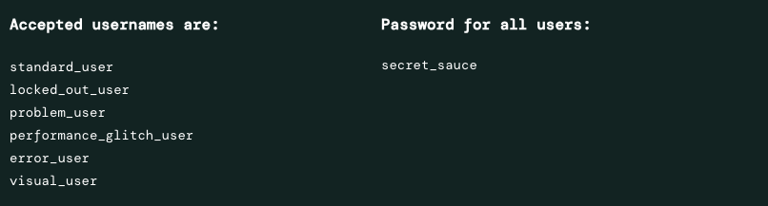
https://www.saucedemo.com/

Slide 116
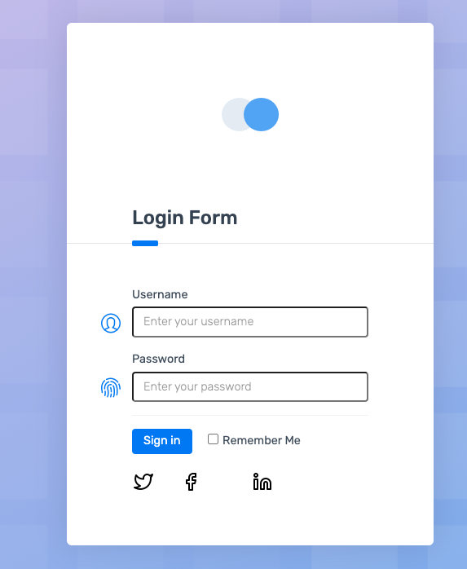
https://demo.applitools.com/#

Slide 117
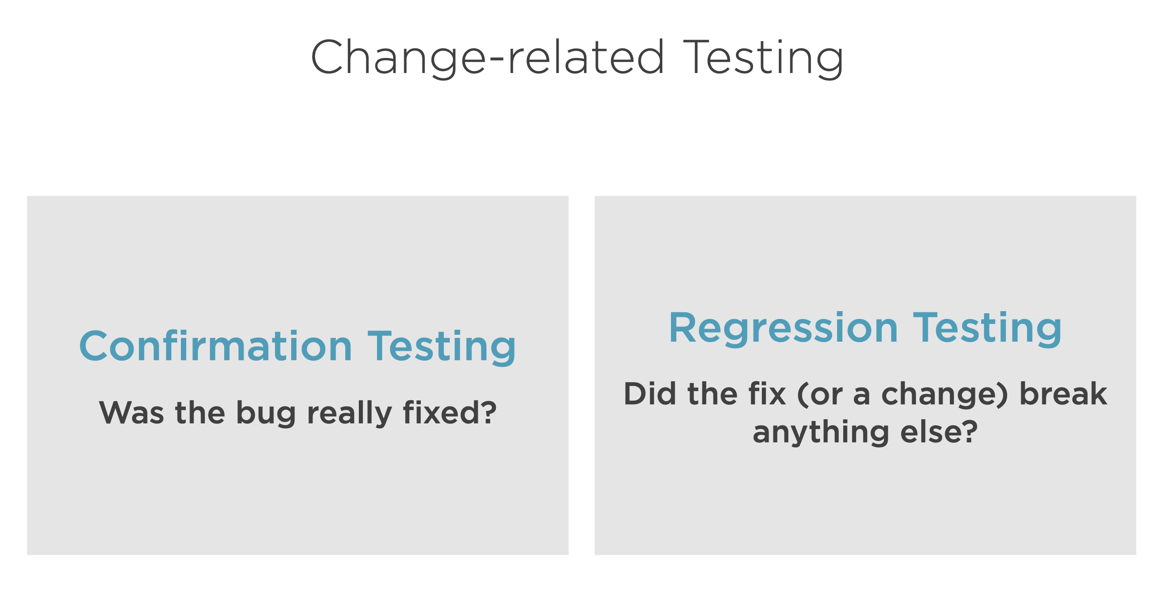

Slide 118
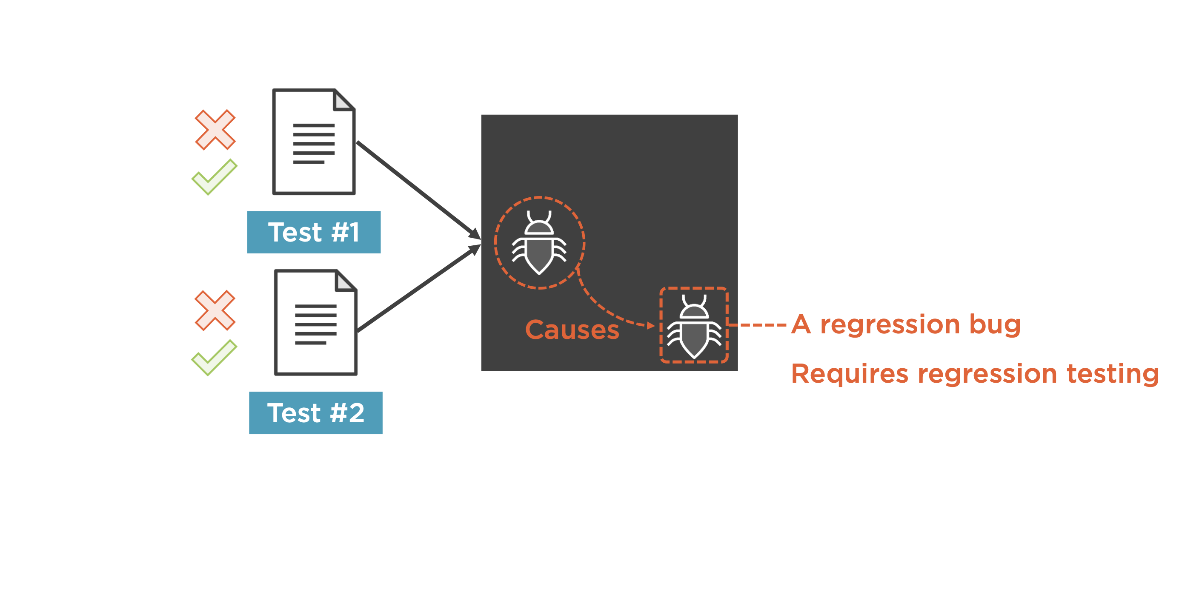

Slide 119
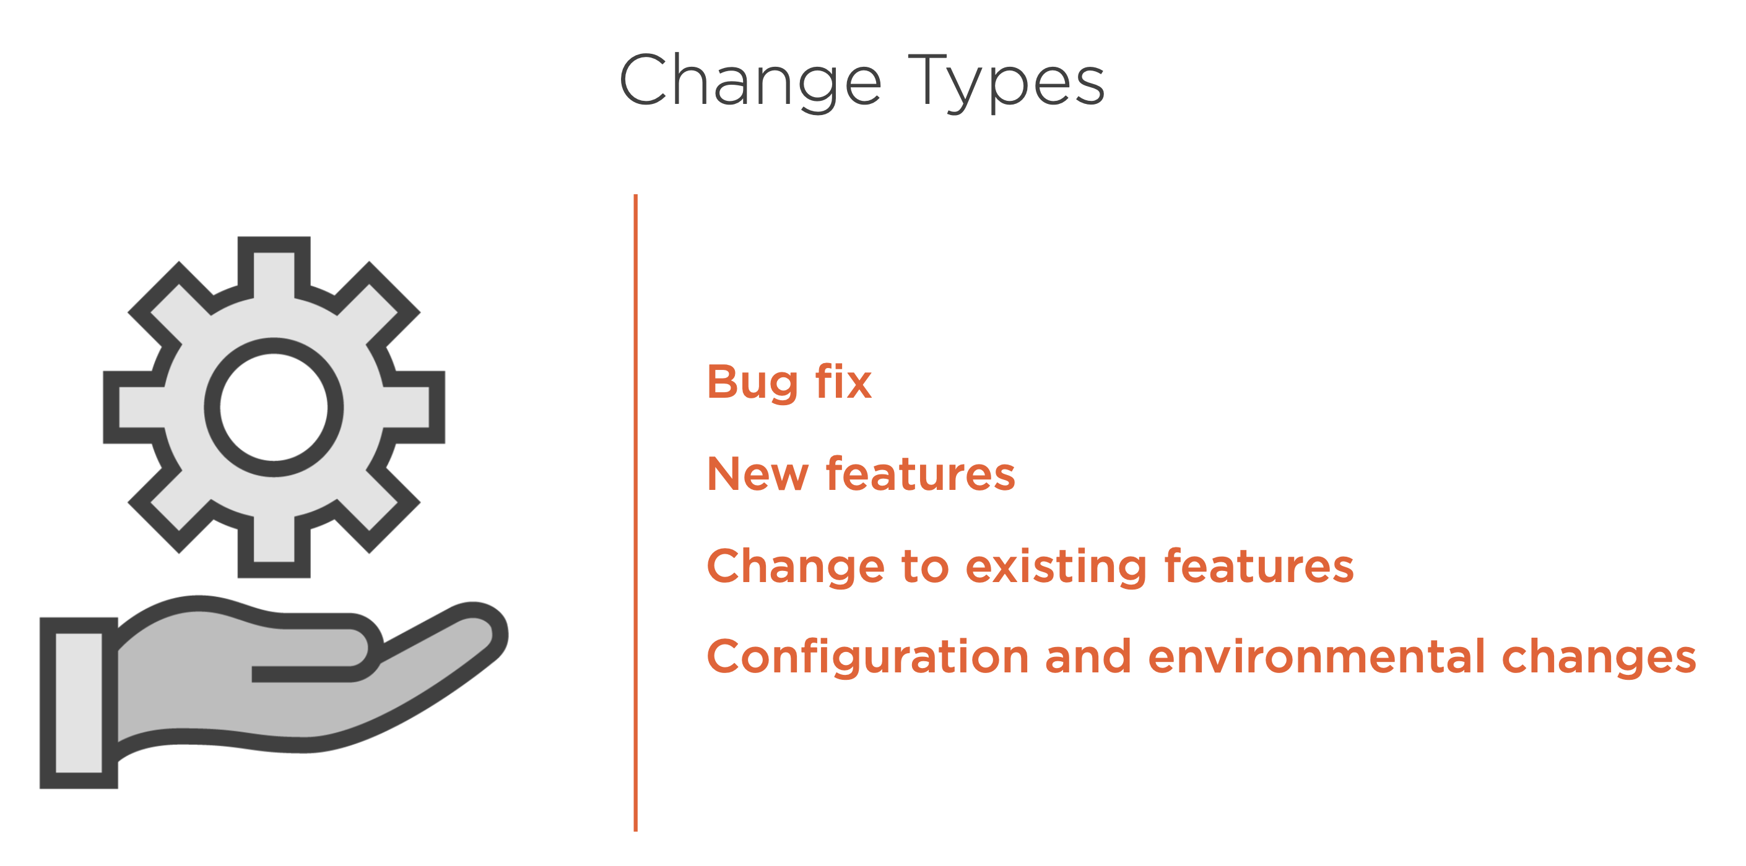

Slide 120
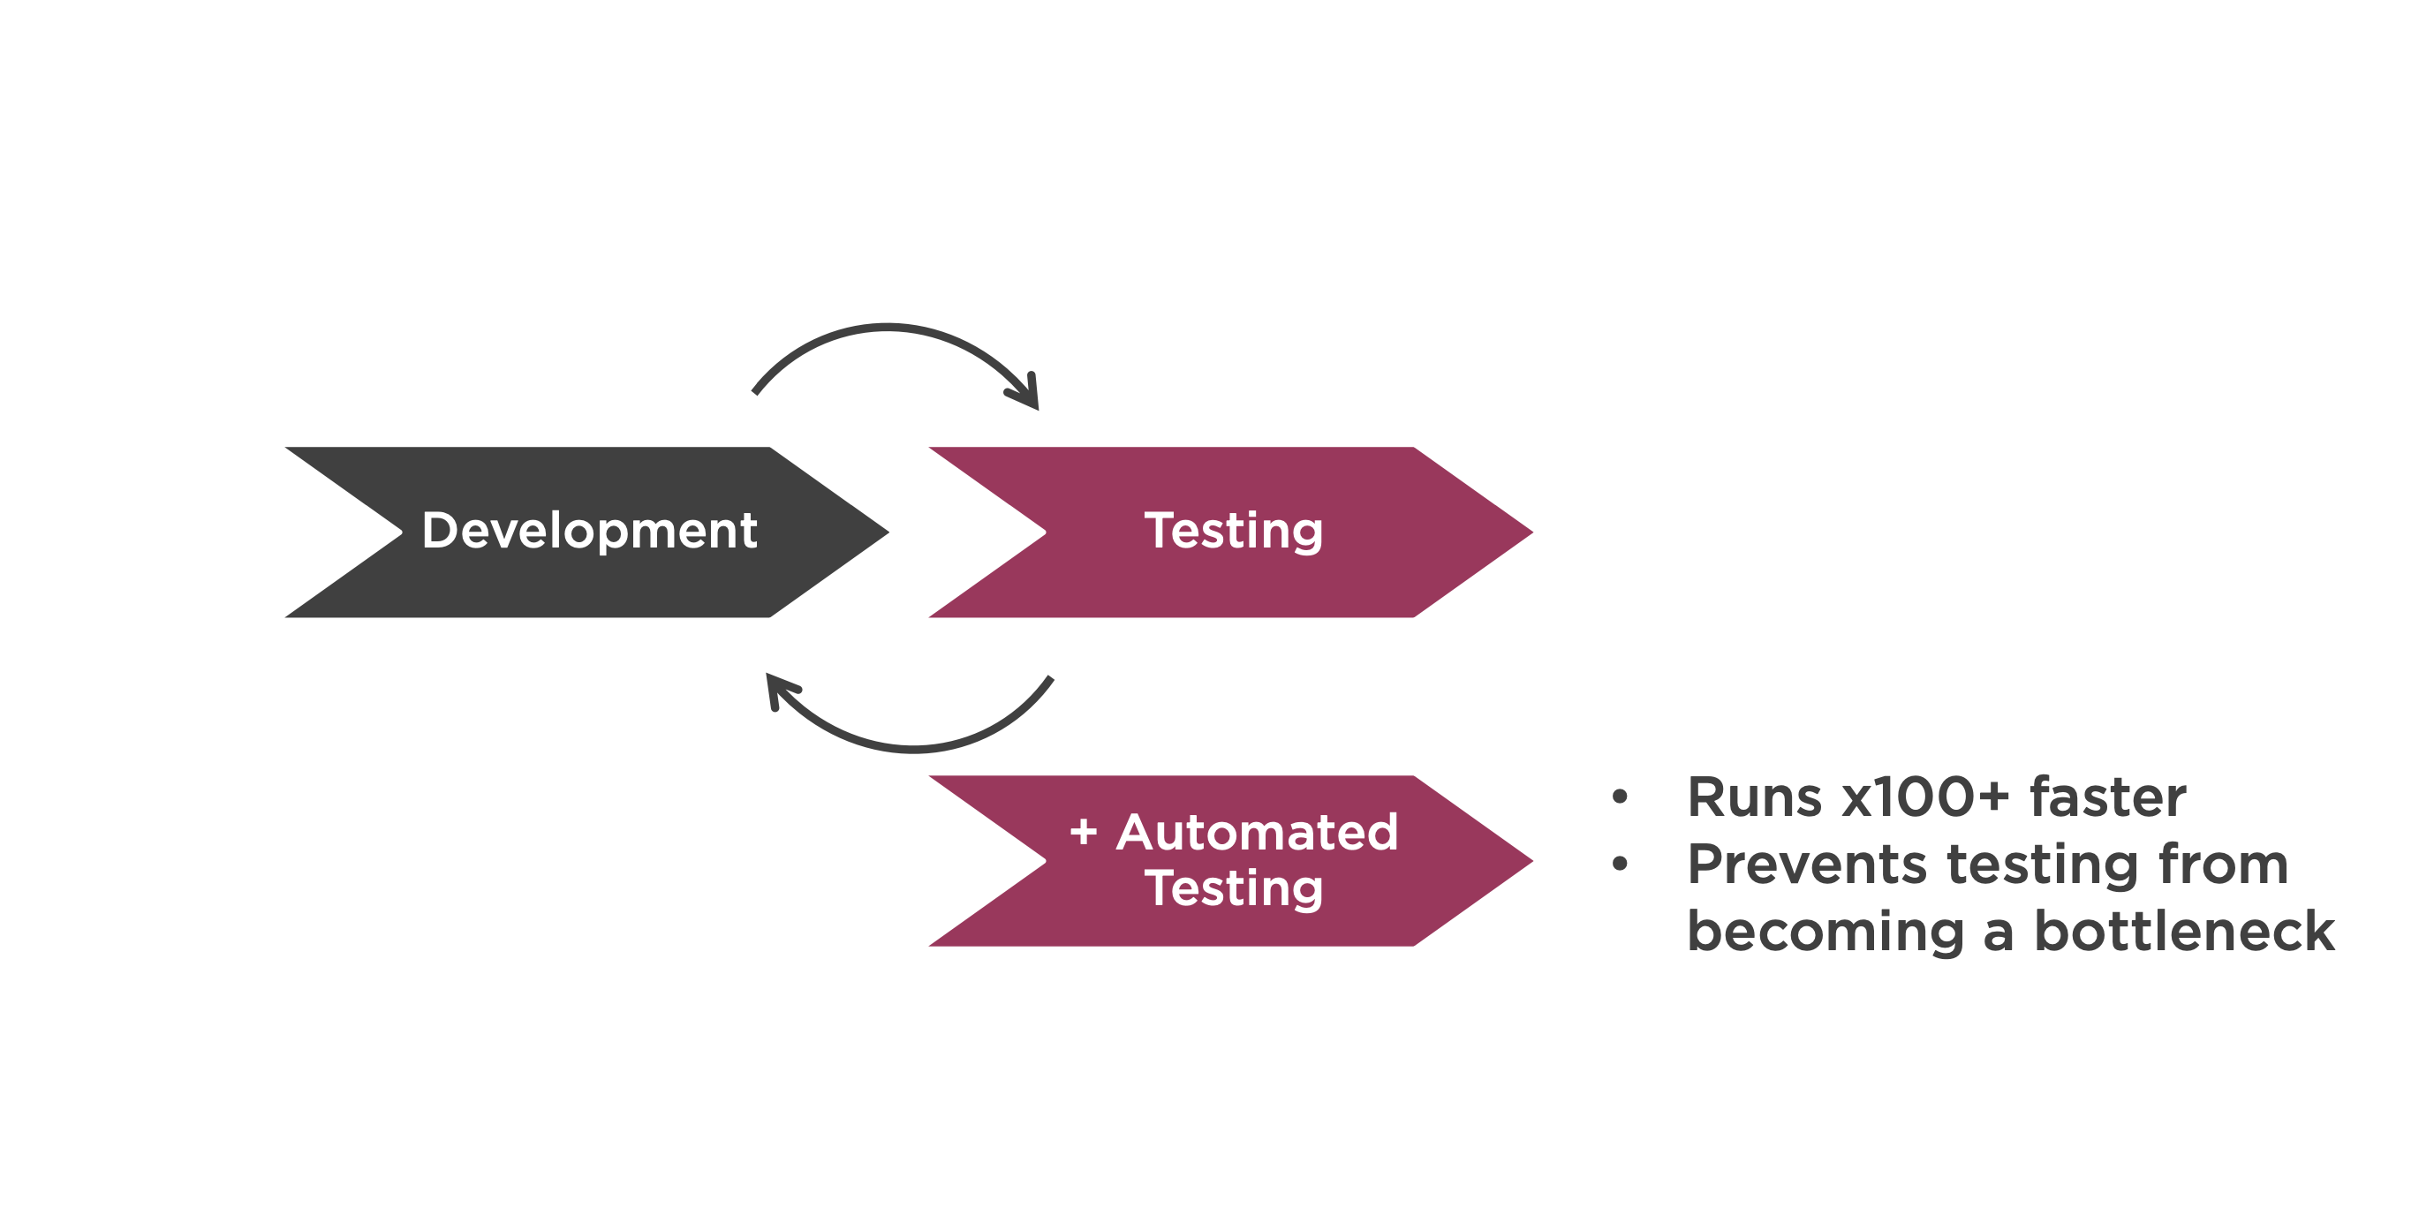

Slide 121

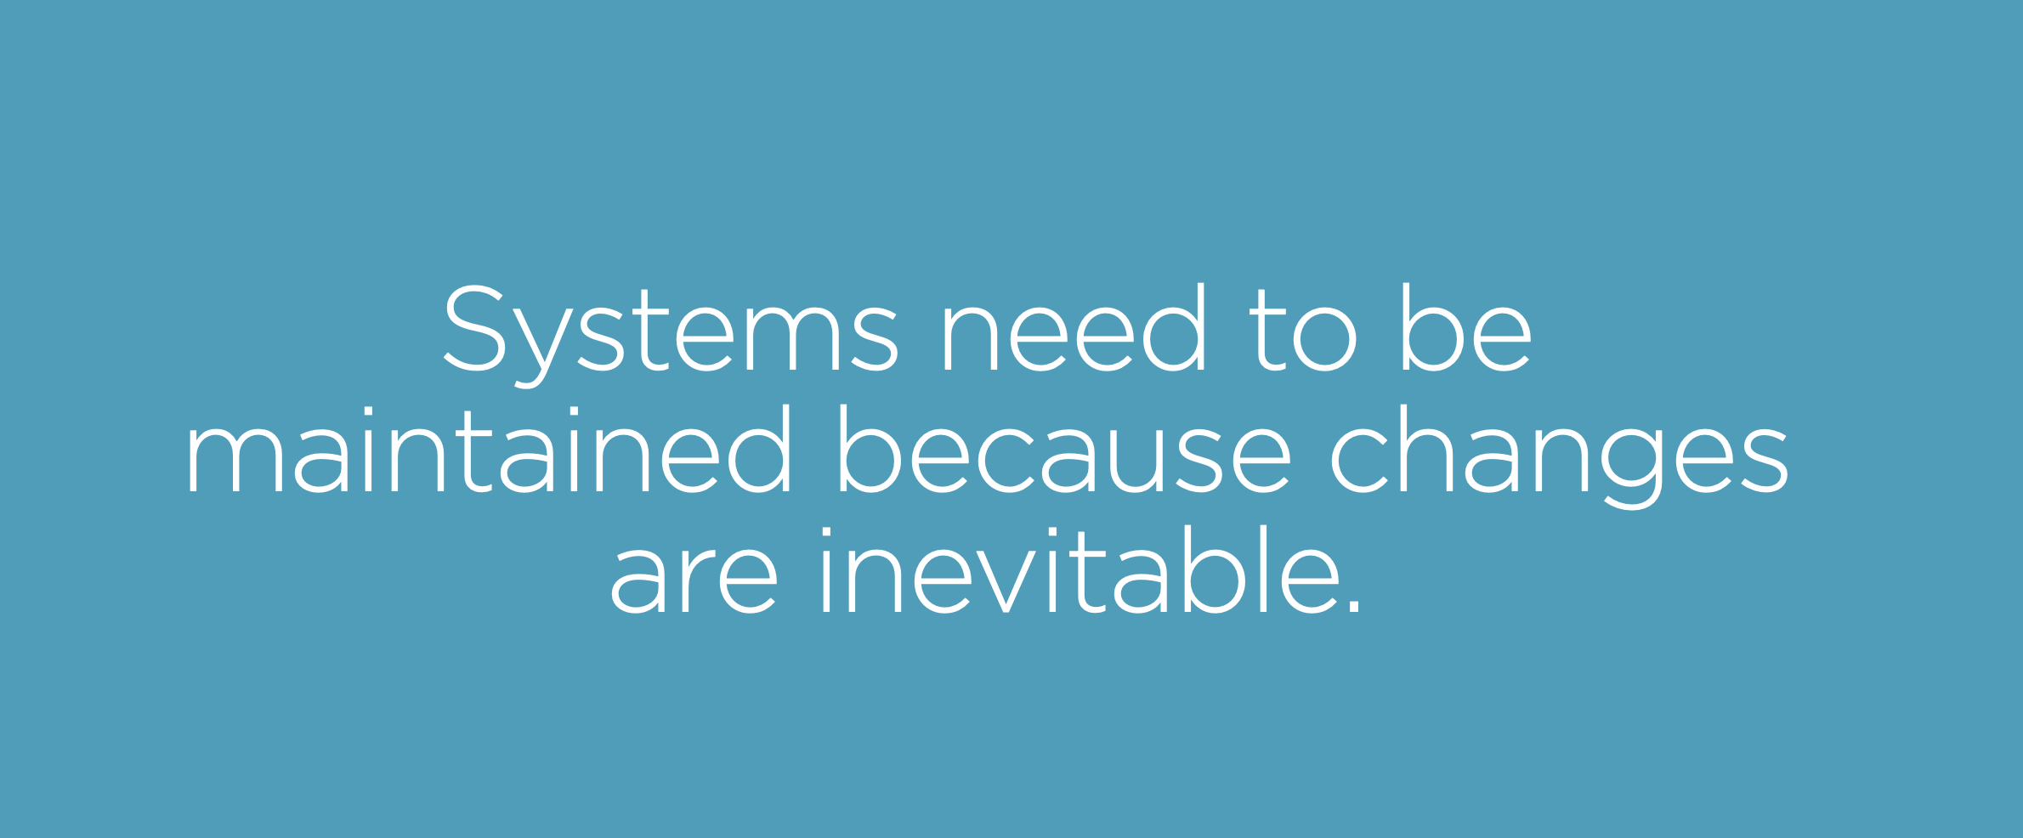

Slide 122
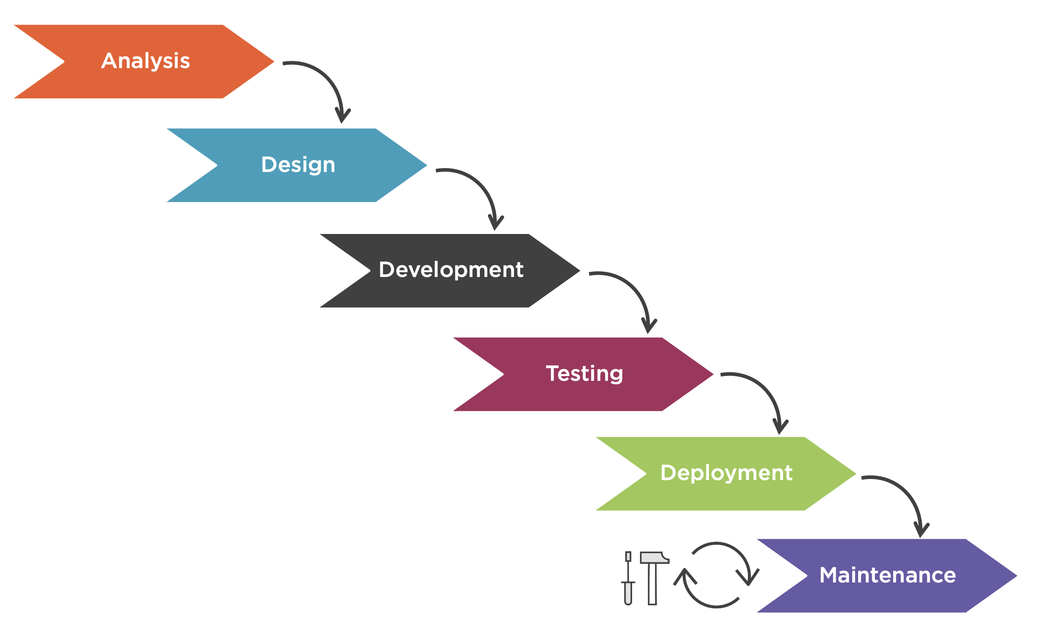

Slide 123
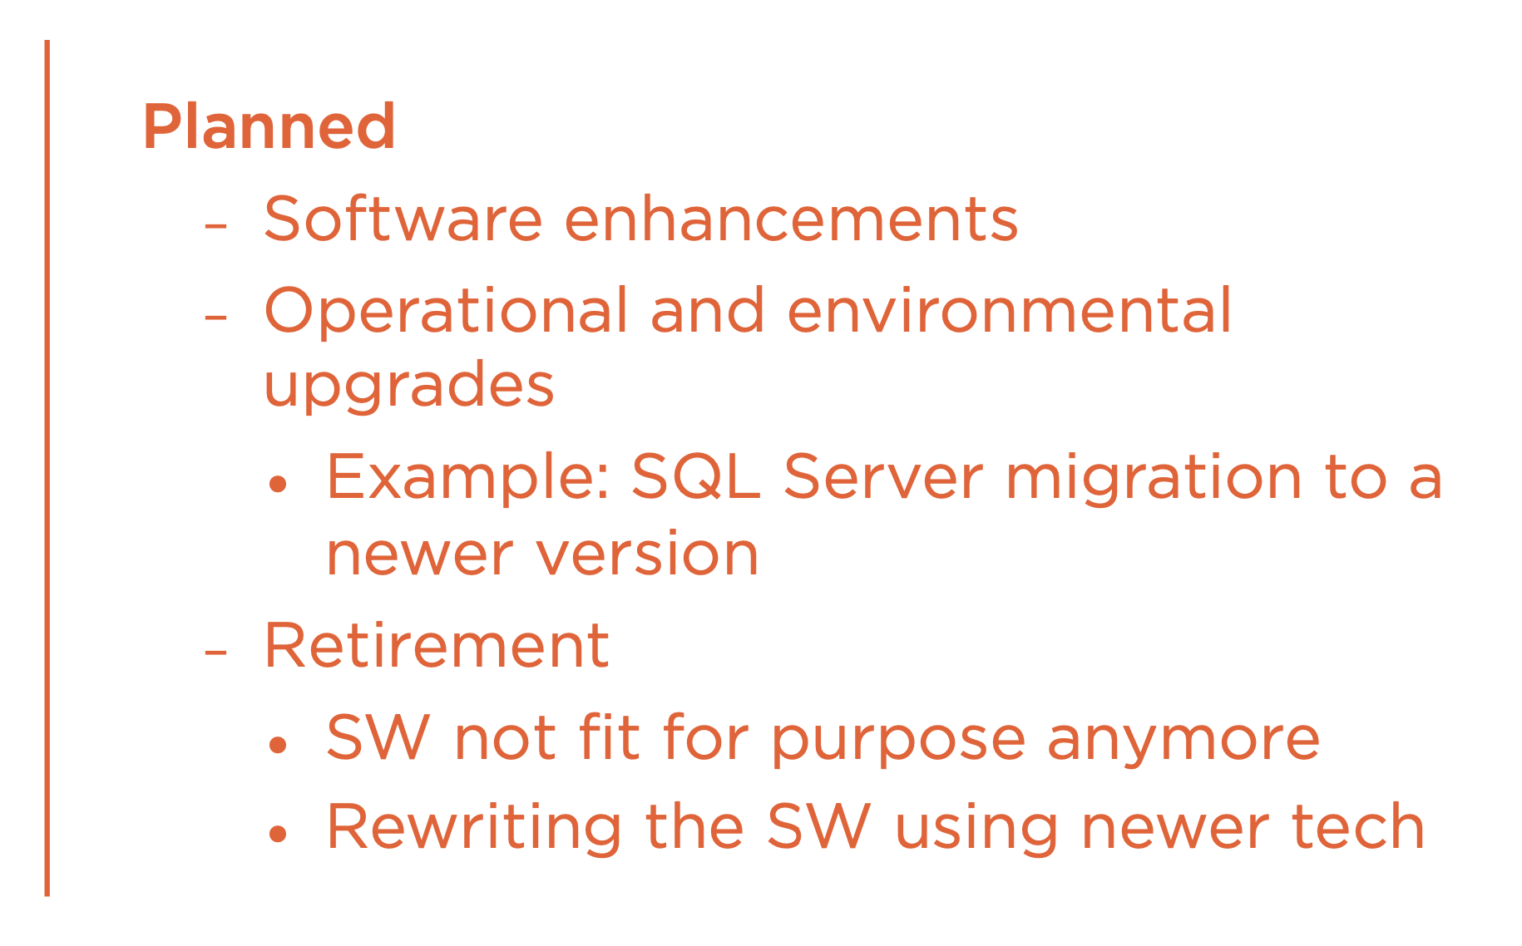
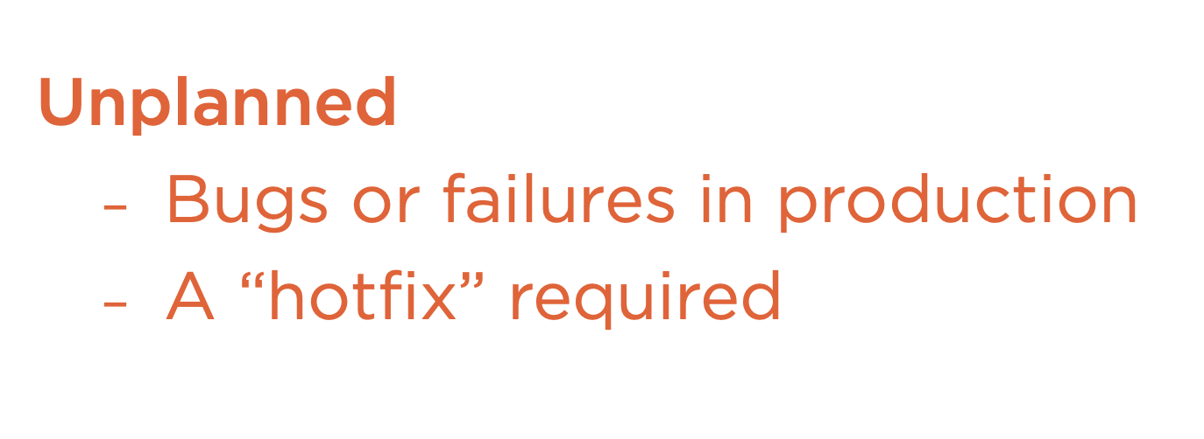

Slide 124

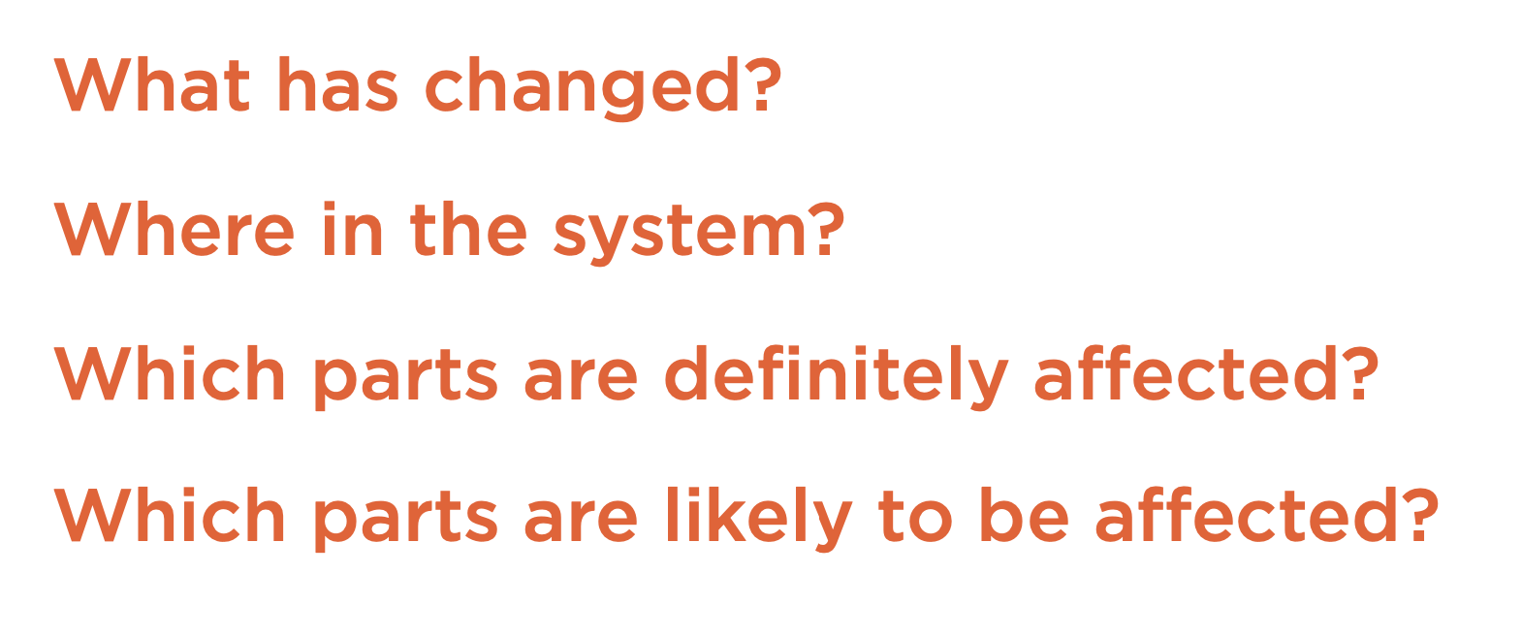

Slide 125
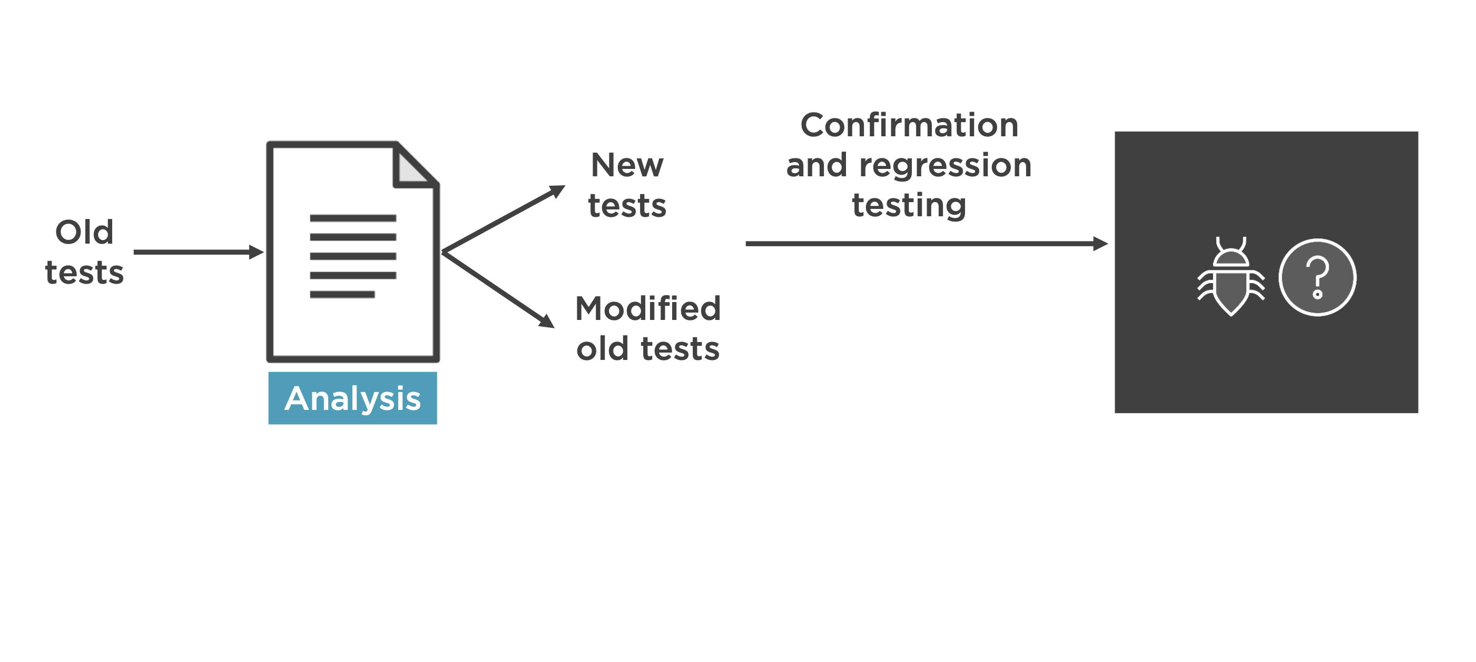

Slide 126
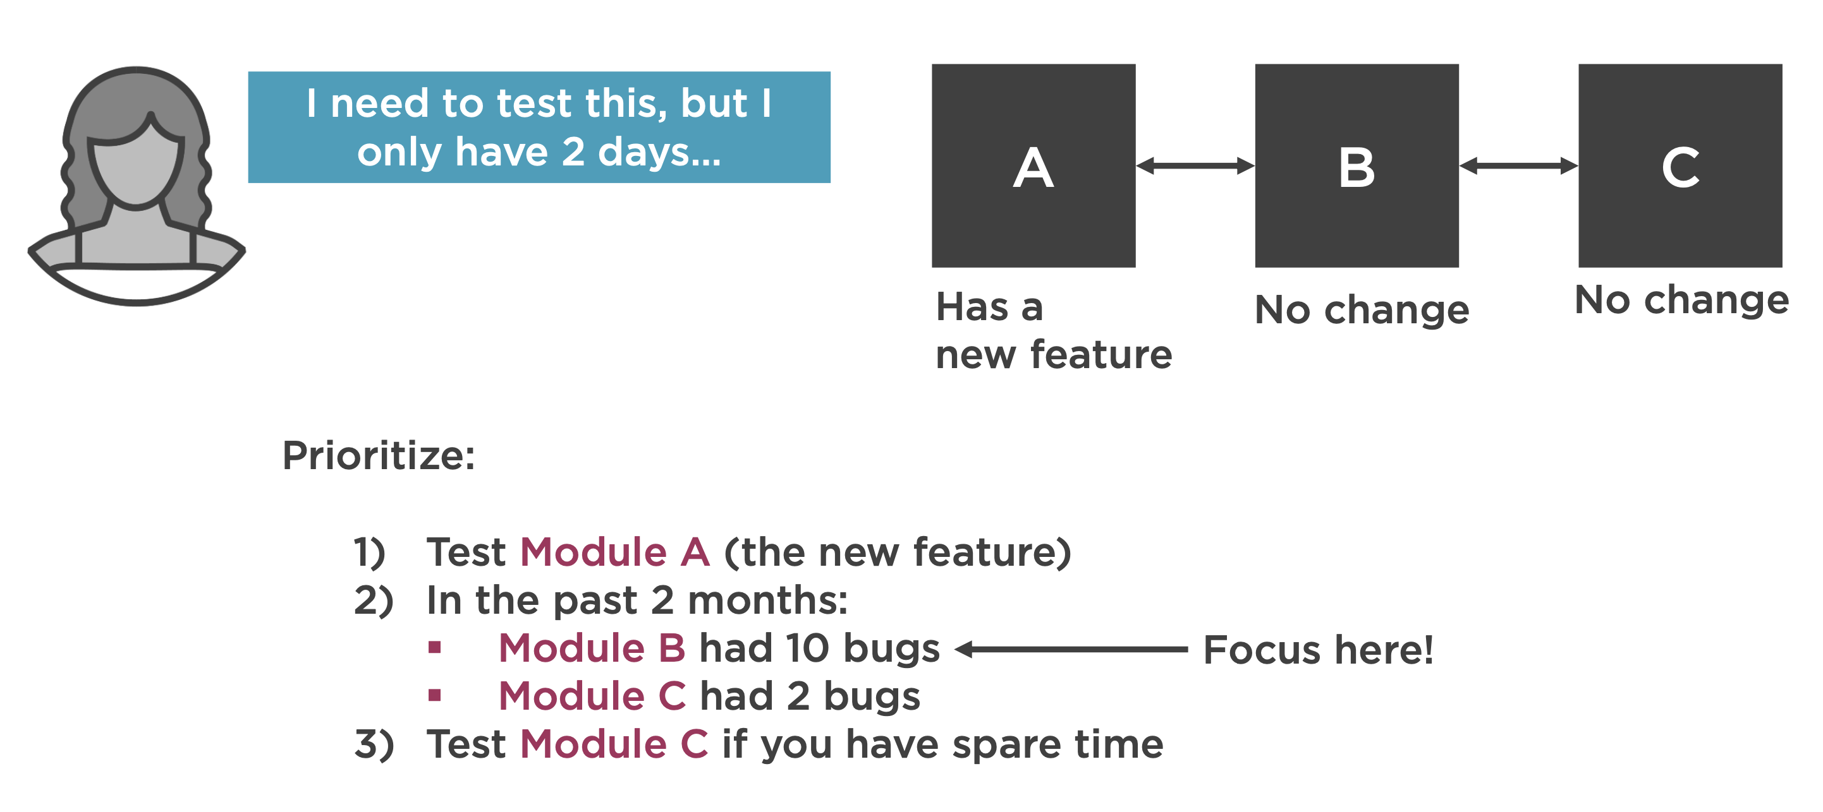

Slide 127
Test Summary Report: Release Note
The final deliverable from a Testing team, that summarizes the
Following
Test Requirements
Features tested
Metrics
Issues & Resolutions
Defect Log

Slide 128
JIRA Test Management Tool Demo

Slide 129
Non-Functional System Testing

Slide 130
Non-Functional System Testing
Non-Functional Testing is defined as a type of Software testing to check non-functional aspects (performance, usability, reliability, etc.) of a software system.
It is designed to test the readiness of a system as per nonfunctional aspects which are never addressed by functional testing.
Non-functional testing is equally important as functional testing and affects client satisfaction.

Slide 131
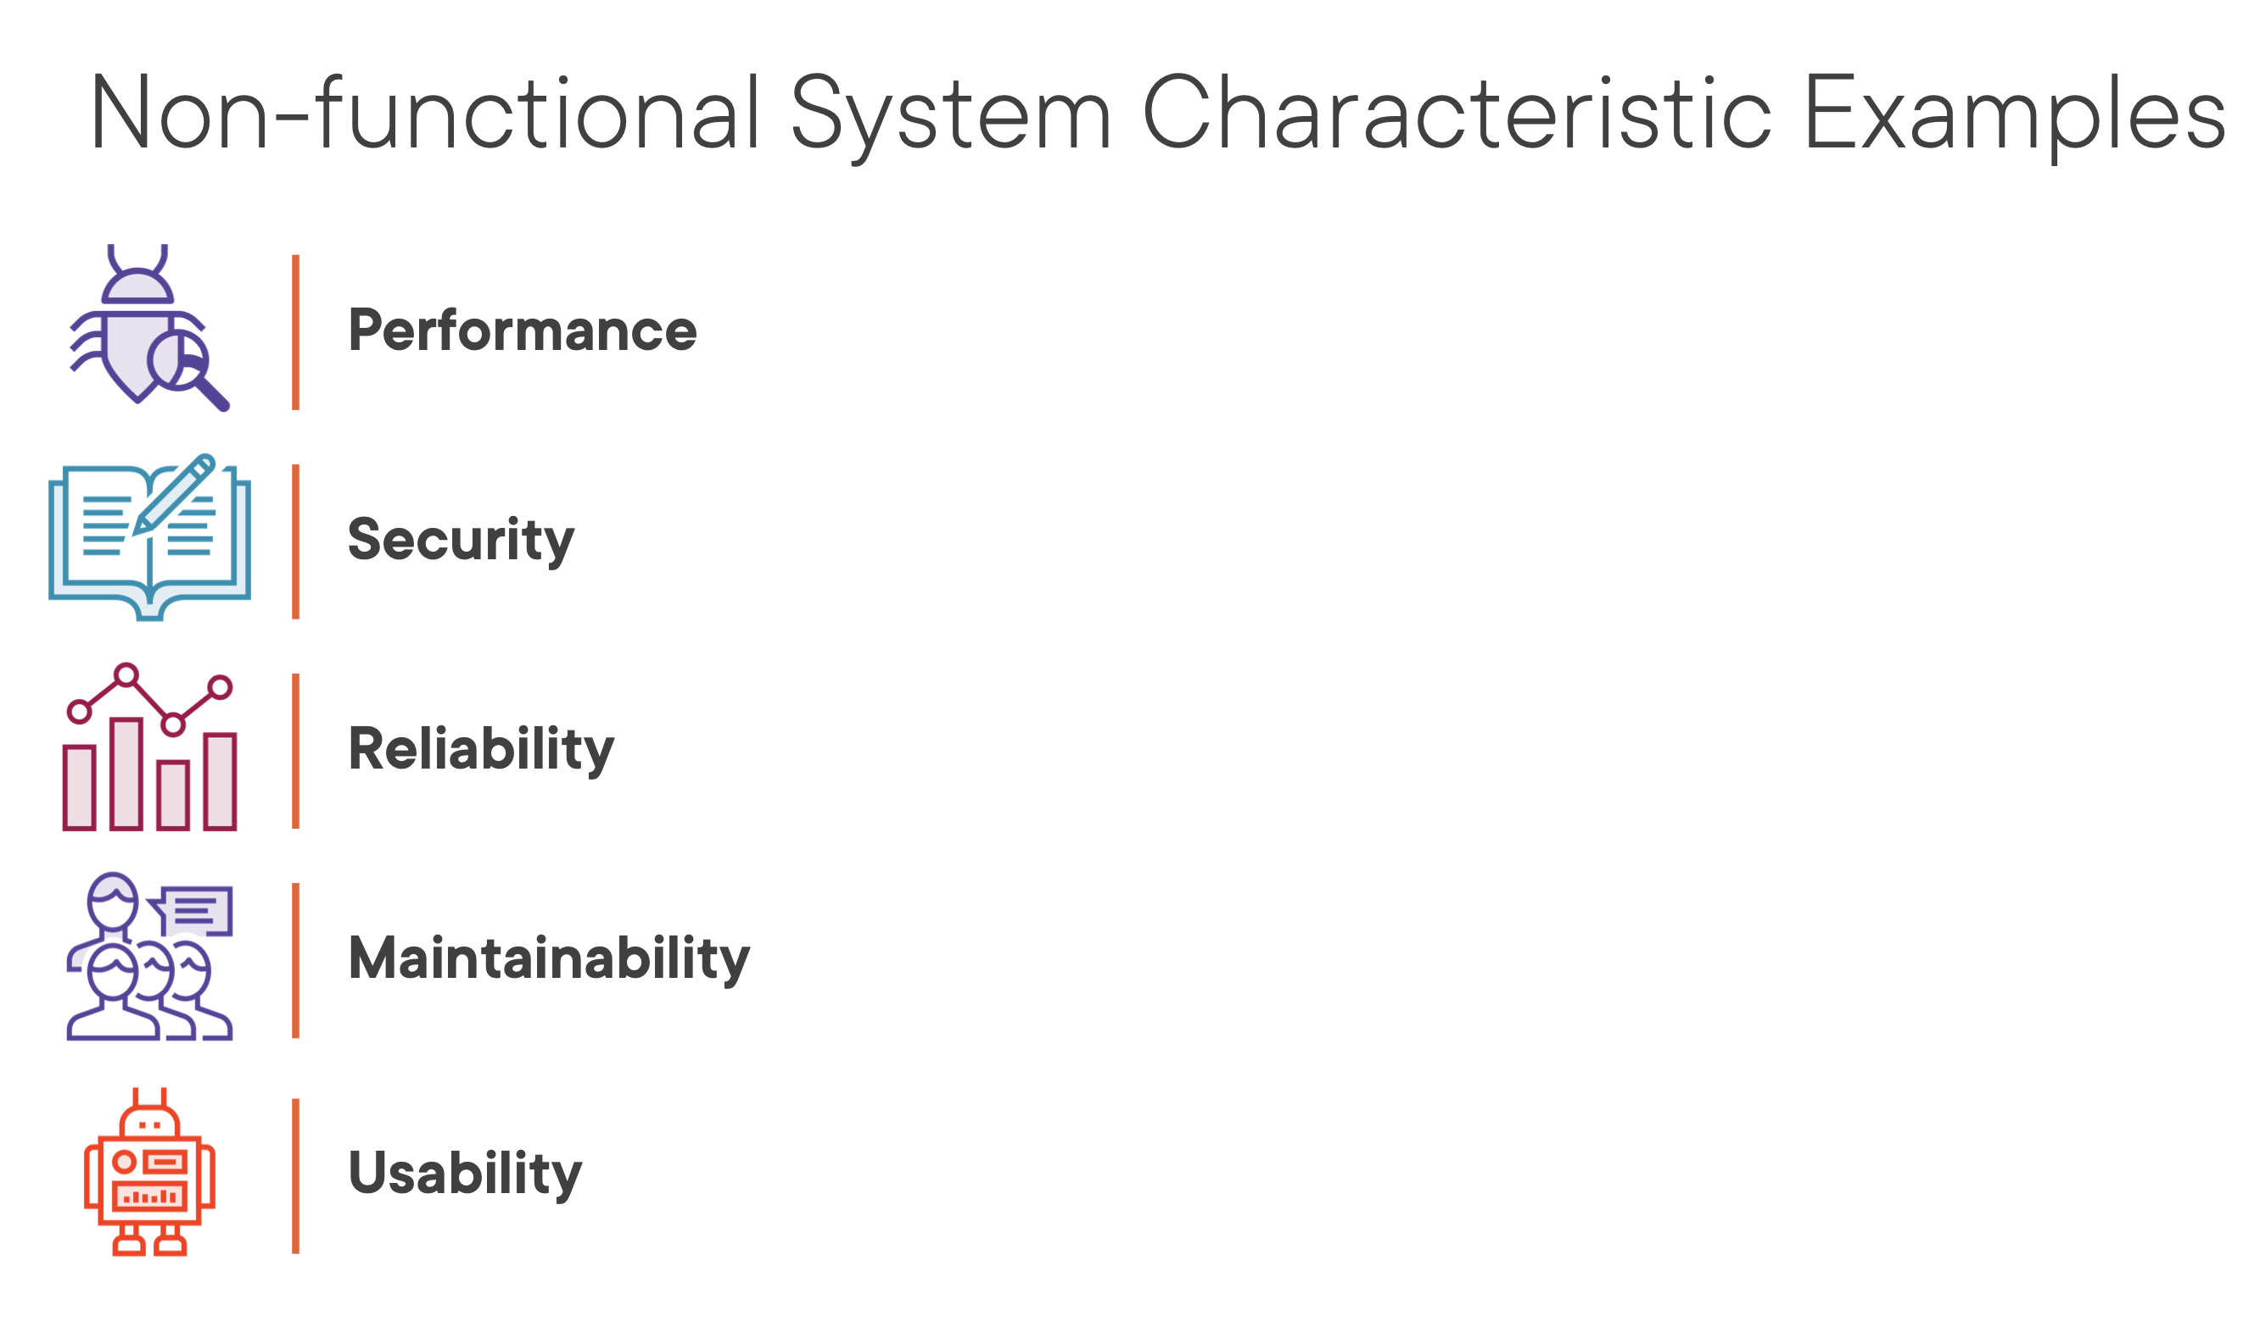

Slide 132
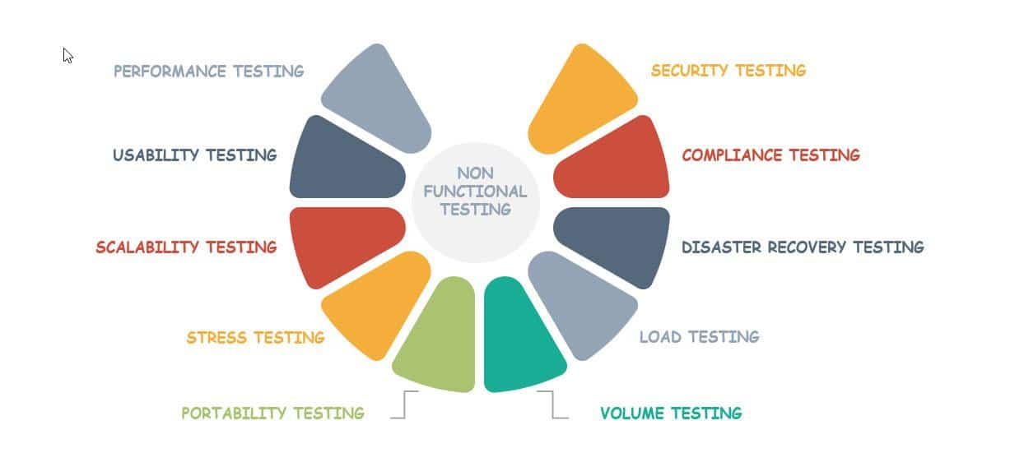
NoN Functional Testing

Slide 133
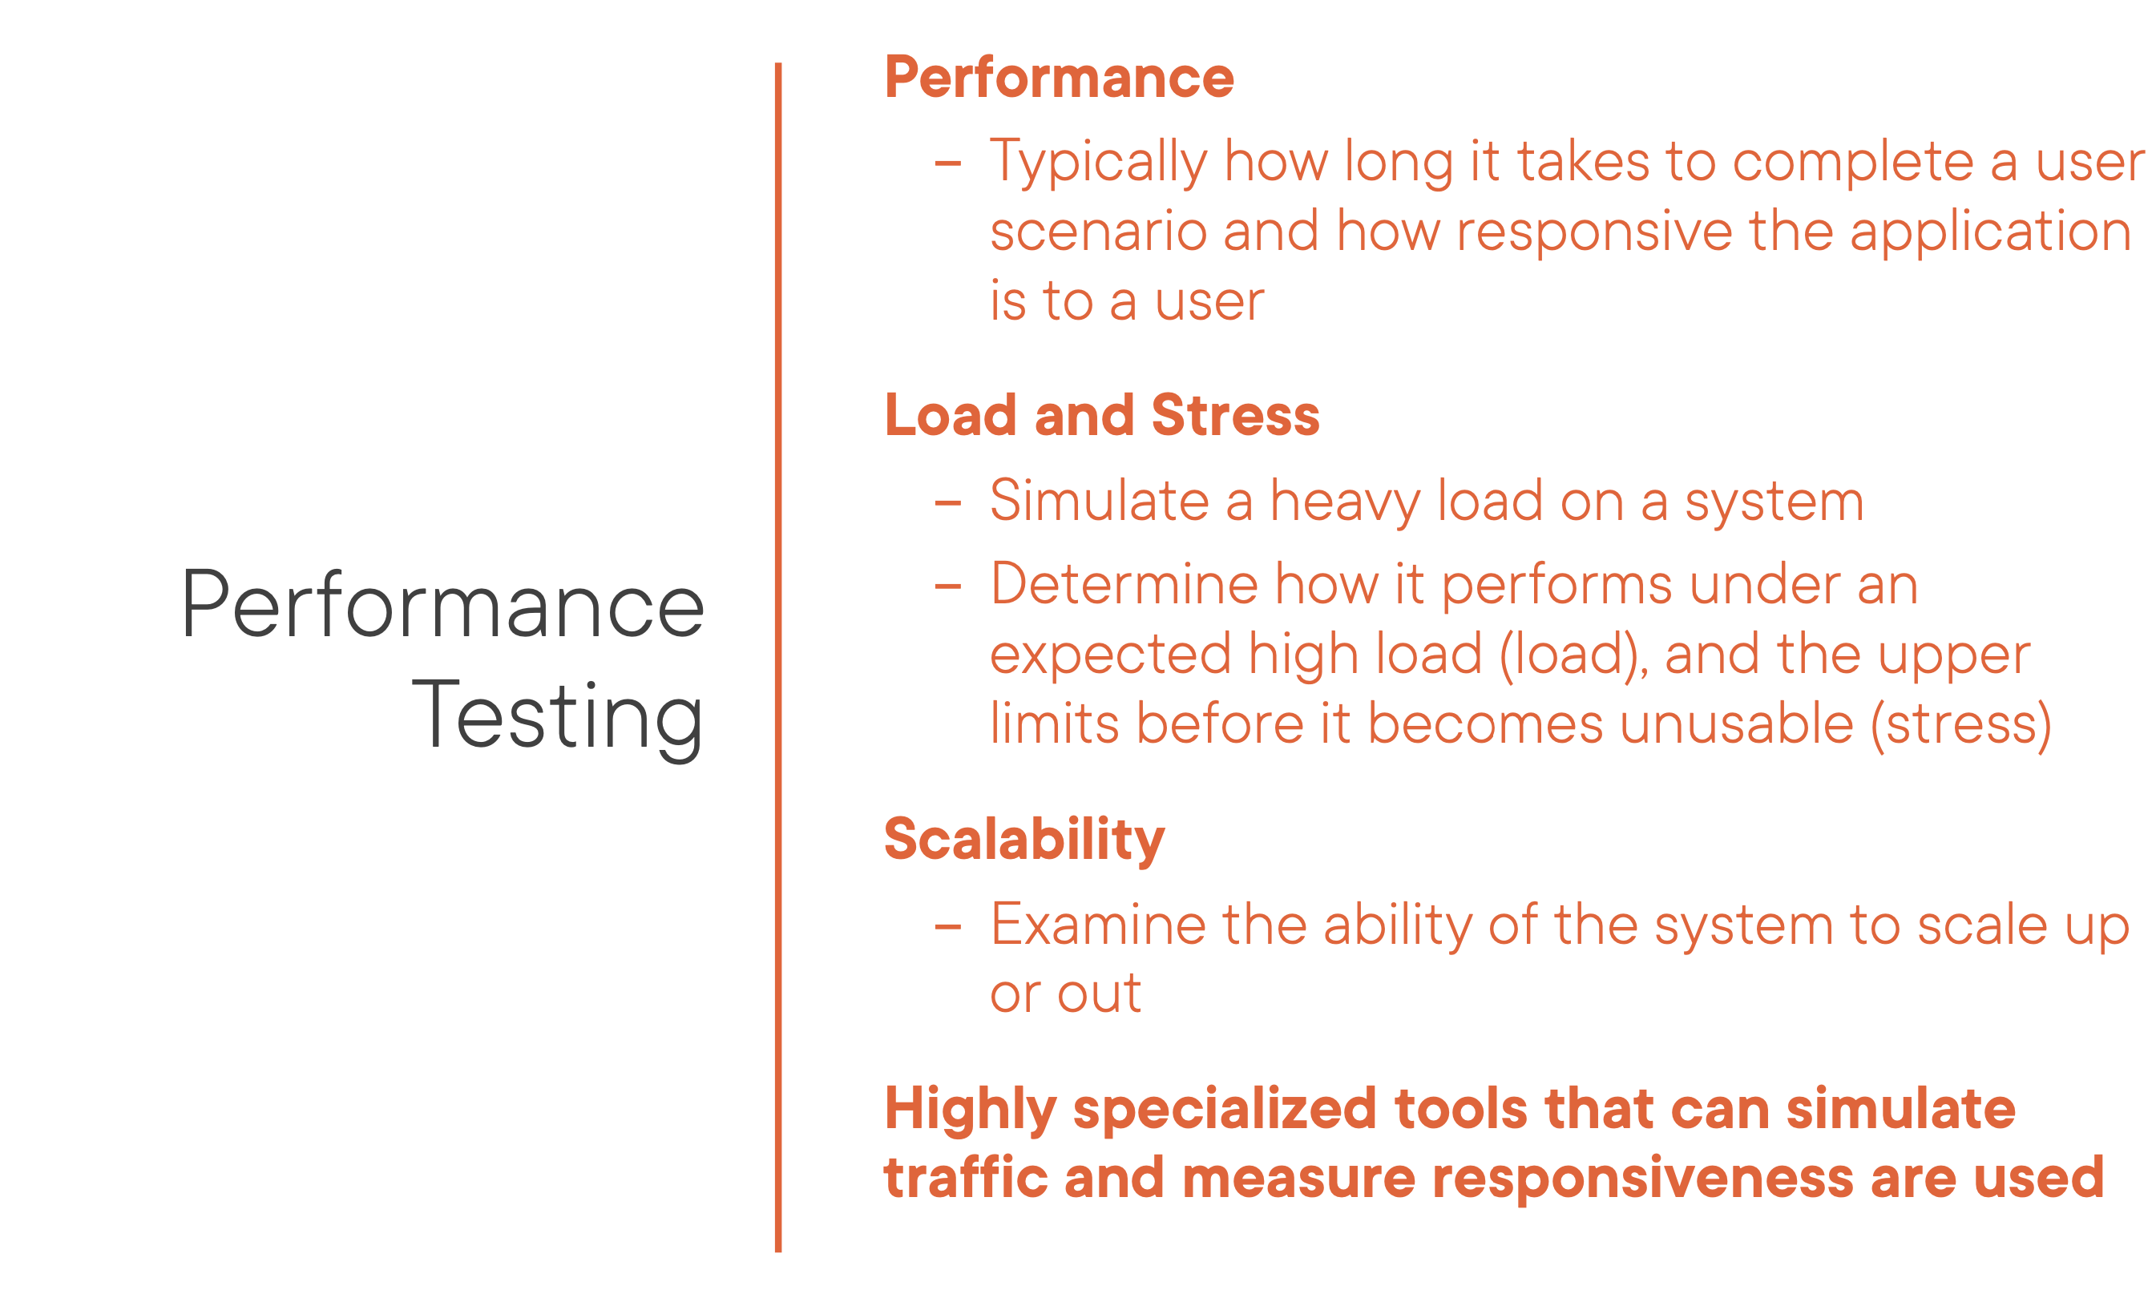

Slide 134
Non-Functional System Testing
Volume Testing:
Evaluates the behavior of the software when a large volume of data is involved.
Key points are:
When the software is subject to large amounts of data, checks the limit where the software fails.
Maximum database size is created and multiple clients query the database or create a larger report.
Example– If the application is processing the database to create a report, a volume test would be to use a large result set and check if the report is printed correctly.

Slide 135
Non-Functional System Testing
Usability Testing:
Evaluates the system for human use or checks if it is fit for use.
Key points are:
Is the output correct and meaningful and is it the same as which was expected as per the business?
Are the errors diagnosed correctly?
Is the GUI correct and consistent with the standard?
Is the application easy for use?

Slide 136
Non-Functional System Testing
Compatibility Testing:
Evaluates that the application is compatible with other hardware /software with minimum and maximum configuration.
Key points are:
Test each hardware with minimum and maximum configuration.
Test with different browsers.
Test cases are the same as those that were executed during functional testing.
In case the number of hardware and software are too many, then we can use Orthogonal Array Testing (OAT) techniques to arrive at the test cases to have maximum coverage.

Slide 137
Non-Functional System Testing
Recovery Testing:
Evaluates that the application terminates gracefully in case of any failure and the data is recovered appropriately from any hardware and software failures.
The tests are not limited to the below points:
Power interruption, to the client while doing CURD activities.
Invalid database-pointers and keys.
Database process is aborted or prematurely terminated.
Database pointers, fields and keys are corrupted manually and directly within the database.
Physically disconnect the communication, power turn off, turn down the routers and network servers.

Slide 138
Accessibility Testing
Check usability by people with disabilities
Blind and low vision, deaf, color-blind, ...
Use accessibility guidelines
Direct usability testing with all relevant groups is usually impractical; checking compliance to guidelines is practical and often reveals problems
Example: W3C Web Content Accessibility Guidelines
Parts can be checked automatically
but manual check is still required
e.g., is the “alt” tag of the image meaningful?

Slide 139
Installation Testing
Before the testing
Configure the system
Attach proper number and kind of devices
Establish communication with other system
The testing
Regression tests: to verify that the system has been installed properly and works

Slide 140
UI testing ("acceptance")
Automated UI testing ("automation")
Scripts and such that use your app and look for failures
A black-box system test
Manual tests
Human beings click through predetermined paths
Need to write down the specific tests each time
Ad-hoc tests
Human beings are "turned loose" on the app to see if they can break it

Slide 141
Usability Test
A usable product
is quickly learned
allows users to work efficiently
is pleasant to use
Objective criteria
Time and number of operations to perform a task
Frequency of user error
Plus overall, subjective satisfaction

Slide 142
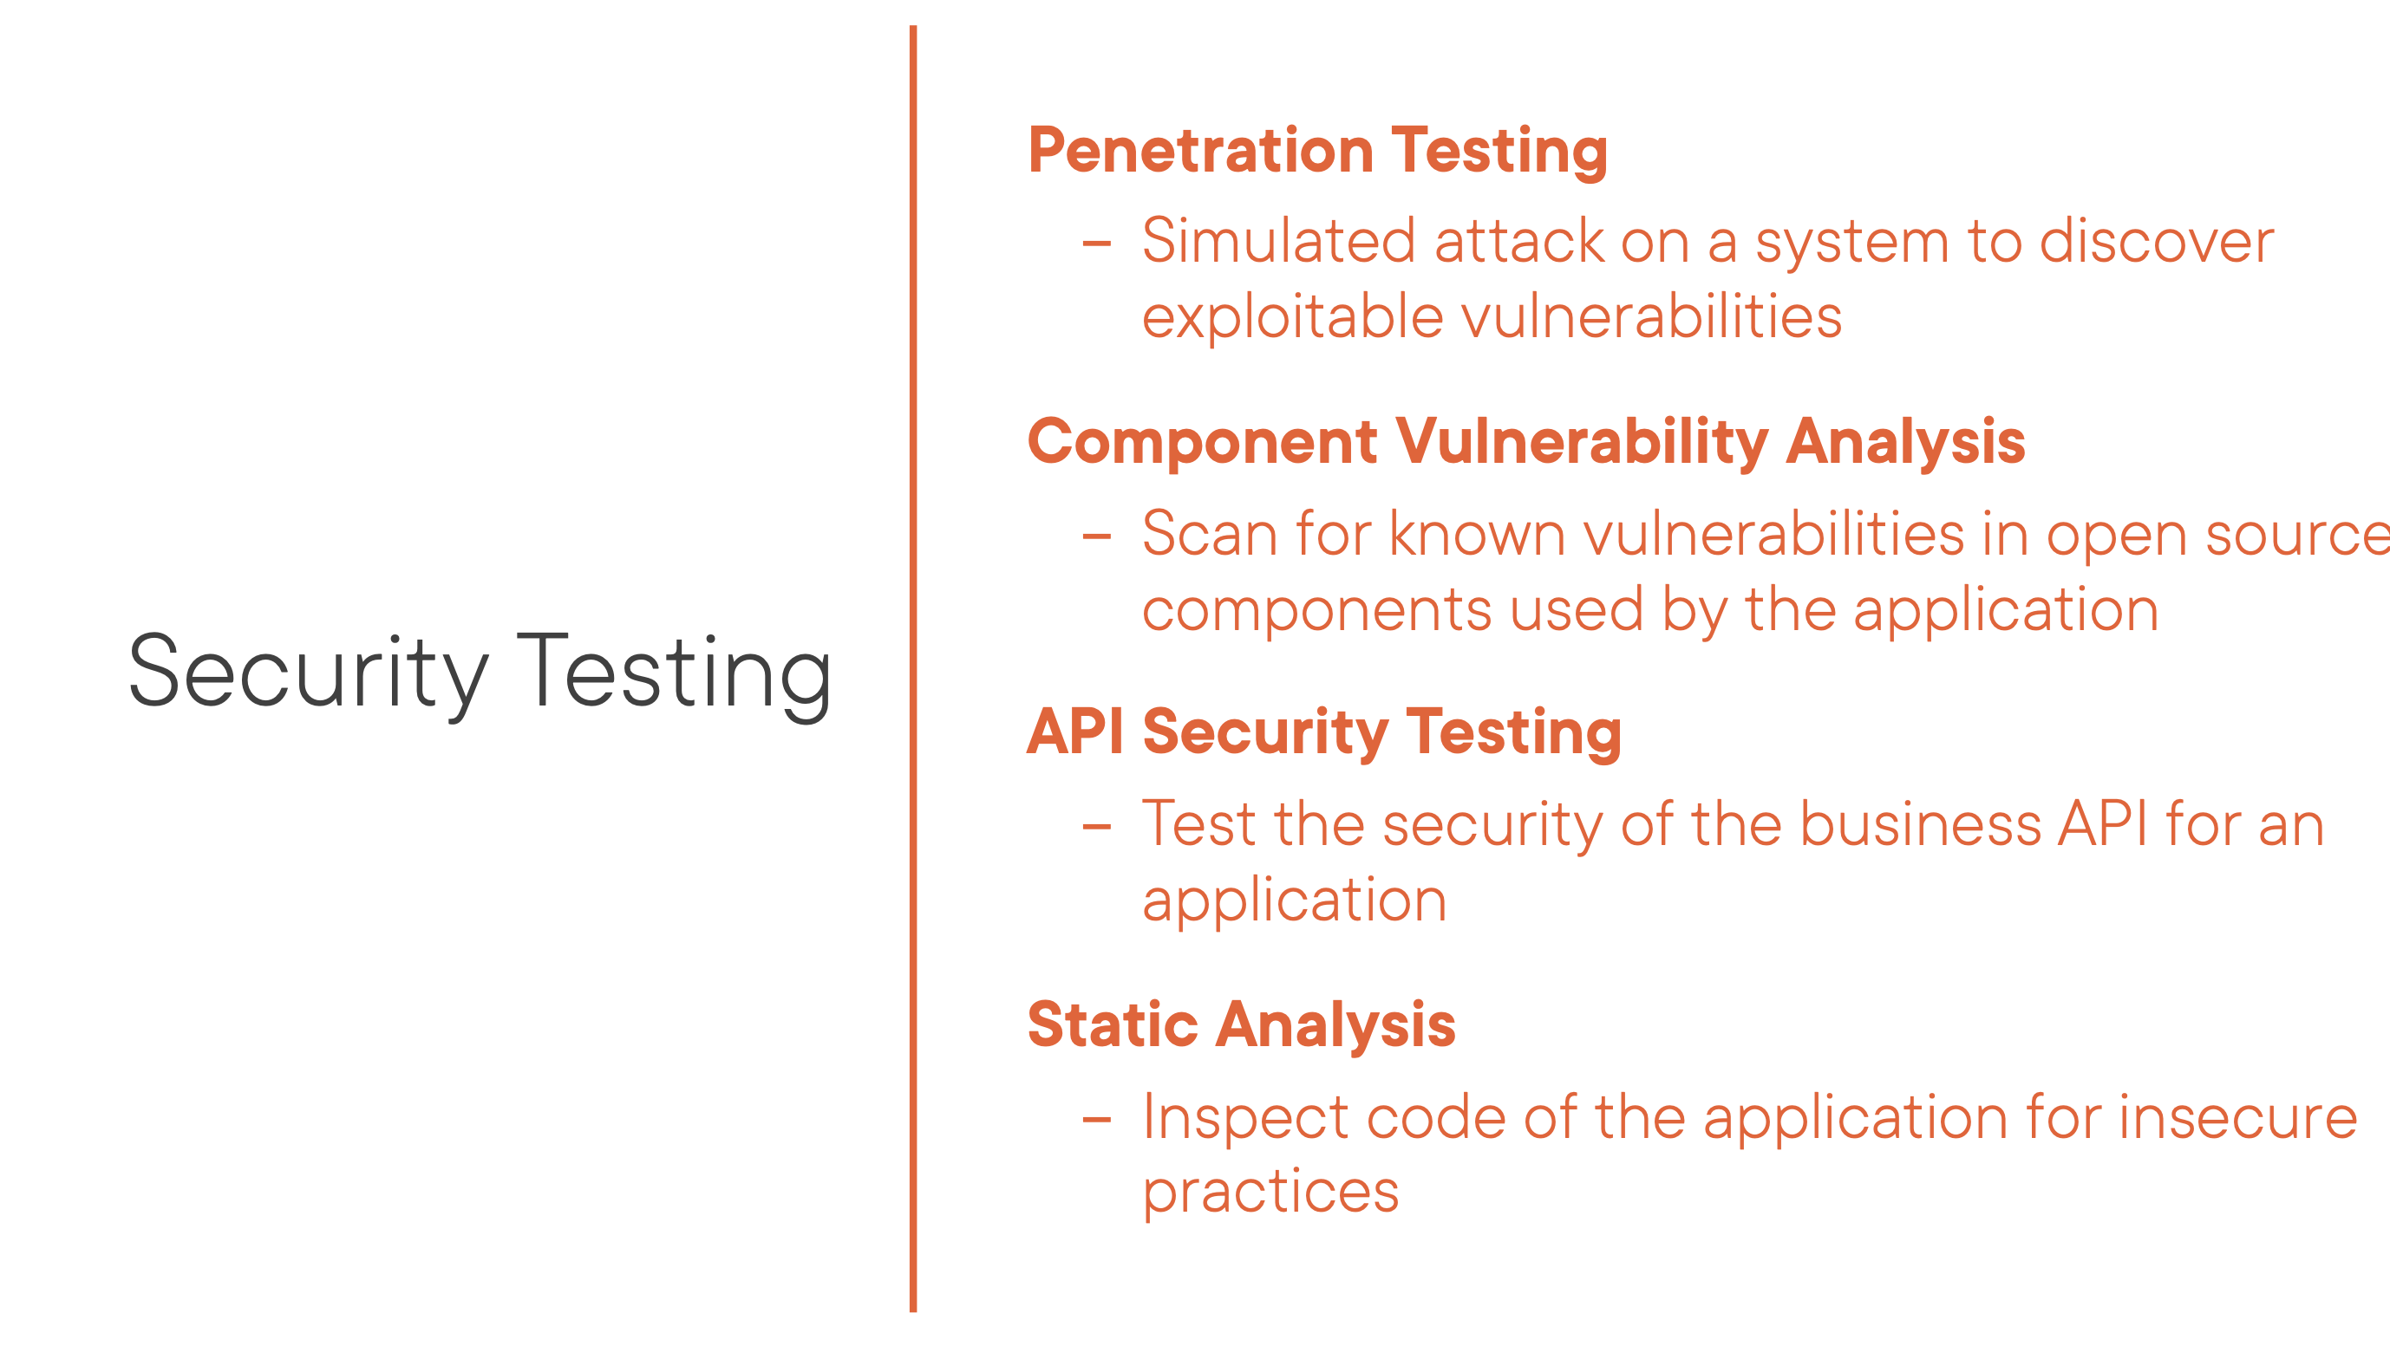

Slide 143
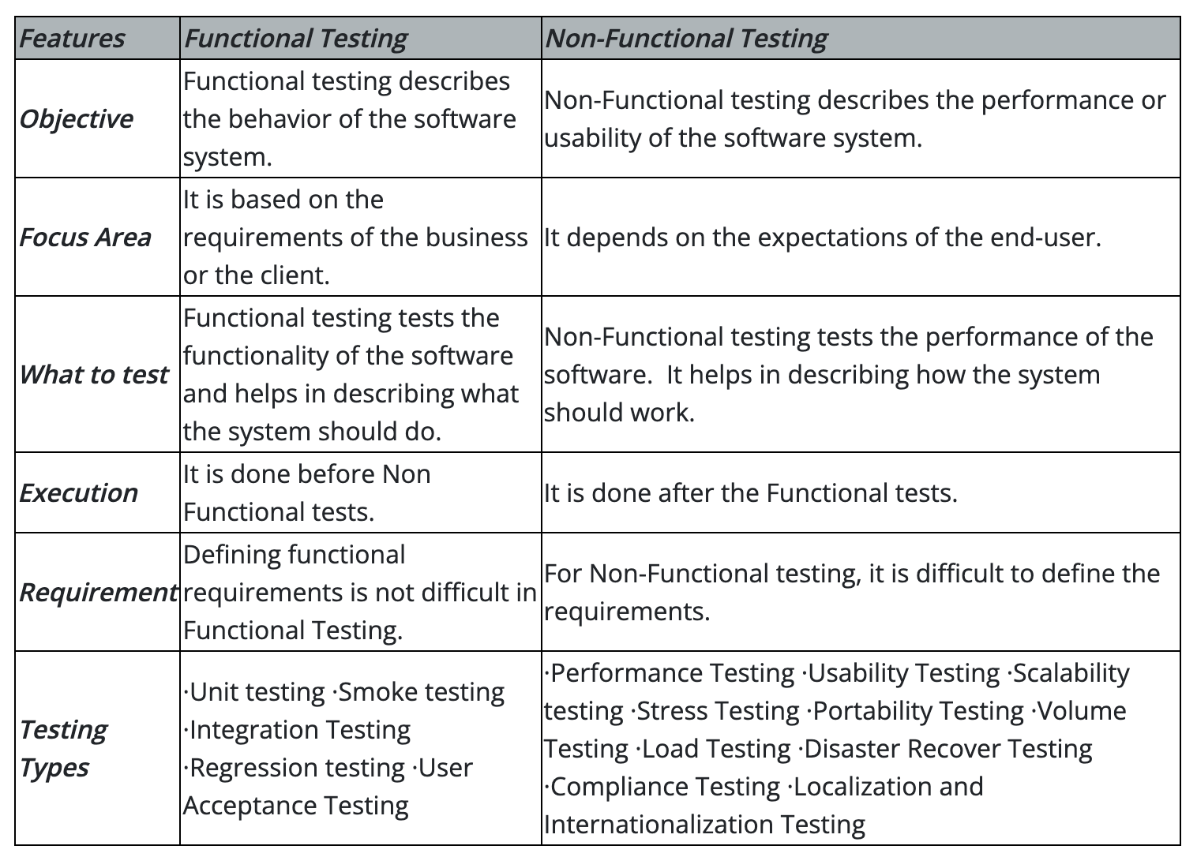
Difference between Functional and Non-Functional Testing

Slide 144
Non-Functional System Testing Tools
There are several tools available in the market for Performance (Load & Stress) testing.
Few of them are listed below:
JMeter
Loadster
Loadrunner
Loadstorm
Neoload
Forecast
Load Complete
Webserver Stress Tool
WebLoad Professional
Loadtracer
vPerformer

Slide 145
Thank You

Slide 146
Appendix

Slide 147
Effective Defect Report
If there is a defect in the software, then that should be proved through a well documented, detailed description of the steps to reproduce the defects and in some cases screen shot of the defect when it occurred. A good defect not only
helps the developers to quickly identify the problem but also help them to prioritize which defects to fix first.
A good defect report is :
A proof for a defect discovered.
Determines the “Quality” of the tester.
Increases the probability of more defects getting fixed.
A critical work product which helps in process improvement and risk management.
Characteristics of a good defect report are that it’s right to the point, lists all appropriate information, and easy to understand.
It is easier and logical to follow a pattern rather that write unorganized and confusing reports.

Slide 148
Defect Tracking & Reporting
Defect tracking is the process of finding defects in a product (by inspection, testing or recording feedback from customers), and making new versions of the product that fix the defects.
Defects are useful
In correcting the software
To predict the quality of the software
To gather statistics used to develop defect expectations in future applications
To take preventive actions like training, establishing methods & procedures etc
To reduce CoQ ( CoQ = Preventive + Appraisal + Failure)
To improve the software development process.
Stakeholders should be informed about
Test progress
Software quality
Defect tracking systems are computer database systems that store defects and help people to manage them. Some third-party defect management tools available are as follows:
HP Quality Center
Bugzilla (Opensource)
JIRA

Slide 149
Performance Testing
Stress Testing
Checks if the system can respond to many simultaneous requests (maximum # of users, peak demands)
Volume testing
Test what happens if large amounts of data are handled
Configuration testing
Test the various software and hardware configurations
Compatibility test
Test backward compatibility with existing systems
Security testing
Try to violate security requirements

Slide 150
Performance Testing
Timing testing
Evaluate response times and time to perform a function
Environmental test
Test tolerances for heat, humidity, motion, portability
Quality testing
Test reliability, maintainability & availability of the system
Recovery testing
Tests system’s response to presence of errors or loss of data.
Human factors testing
Tests user interface with user

Slide 151
Non-Functional System Testing
Performance Testing:
Evaluates the overall performance of the system.
Key elements are as follows:
Validates that the system meets the expected response time.
Evaluates that the significant elements of the application meet the desired response time.
It can also be conducted as a part of integration testing and system testing.

Slide 152
Non-Functional System Testing
Load Testing:
Evaluates whether the system’s performance is as expected under normal and expected conditions.
Key points are:
Validates that the system performs as expected when concurrent users access the application and get the expected response time.
This test is repeated with multiple users to get the response time and throughput.
At the time of testing, the database should be realistic.
The test should be conducted on a dedicated server which stimulates the actual environment.
How many hits/requests should the system be able to handle?
What should be its performance under these circumstances?

Slide 153
Non-Functional System Testing
Stress Testing:
Evaluates whether the system’s performance is as expected when it is low on resources.
Key points are:
Test on low memory or low disc space on clients/servers that reveal the defects which cannot be found under normal conditions.
Multiple users perform the same transactions on the same data.
Multiple clients are connected to the servers with different workloads.
Reduce the Think Time to “Zero” to stress the servers to their maximum stress.
Think Time: Just like the time interval between typing your user and password.

Slide 154
Stress Testing
Often requires extensive simulation of the execution environment
With systematic variation: What happens when we push the parameters? What if the number of users or requests is 10 times more, or 1000 times more?
Often requires more resources (human and machine) than typical test cases
Separate from regular feature tests
Run less often, with more manual control
Diagnose deviations from expectation
Which may include difficult debugging of latent faults!

